Slide 1
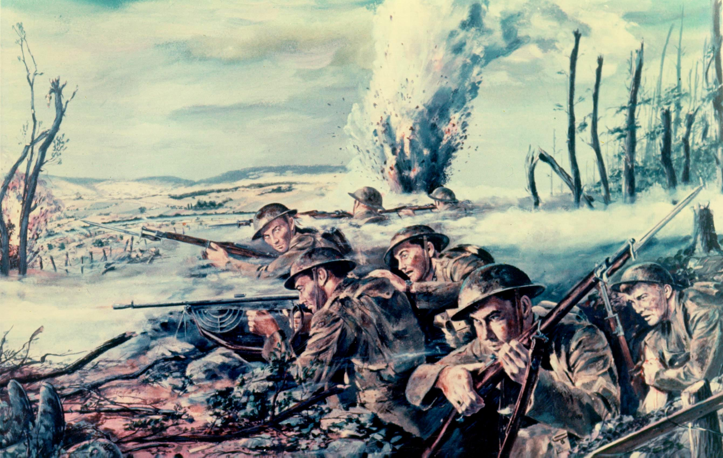
World History: Unit 1 WWI

Slide 2
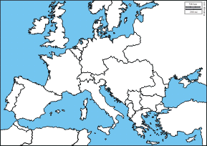
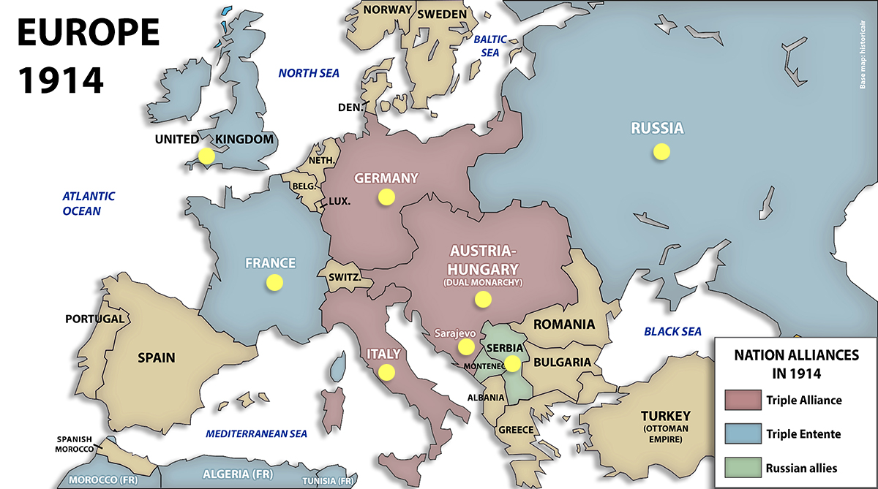

Slide 3
The Main Causes of WWI
Nationalism
Economic Rivalry
The Arms Race
The System of Alliances

Slide 4
Nationalism
In Europe

Slide 5
French Nationalism
During the Franco-Prussian War in 1871, Alsace-Lorraine, a French region rich in coal and iron, was lost by France to Germany. Germany won this war and the prize was this territory. This region soon became very important for Germany, not only because of their land’s resources but also because of its military strength.
As the years progressed the people of Alsace-Lorraine began to hate German control of them. They soon became extremely nationalistic and tried to reunite themselves with France.

Slide 6
German Nationalism
Feelings of superiority and pride in Germany arose from the imperialist race of the late 1800’s. After the unification of German states (Prussia) in 1871, Germany quickly rose up as a strong nation with rapid industrial and technological growth. As a result of their ascension into power the Germans became proud of their land and their newfound status.
While still being far from comparable to other powerful nations in Europe and certainly late on the imperialist scene, they began to slowly build their empire. Some powerful German citizens feared that they were too late in the game and the most powerful empires (GB and France) had already acquired all the important « good » nations up for grabs. They also believed that GB and France would team up to block Germany from becoming stronger. #paranoid

Slide 7
Austro-Hungarian Nationalism
Since Austria-Hungary was a multicultural empire (Serbs, Croats, Slavs, Czechs and poles) their nationalism was spread out. Because of this, their empire was very weak and by 1914 there had already been a number of conflicts in the Balkans by these groups all fighting for legitimacy of their interests. There wasn’t one unified country fighting against other powerful nations. The conflict was within.

Slide 8
Pan Slavism
Here we see the union of Russia and Serbia. The Russian people offered to join the Serbs so as to protect them in the Balkan wars. They wanted to help Serbia free themselves from the Austro-Hungarian hold. This offer of protection is what is referred to as Pan Slavism.

Slide 9
British Nationalism
The largest economic and imperial power of the 1900’s was Great Britain. Nationalism was a result of their reputation. They prided themselves on their military and navy, and expansive empire « the sun never sets on the British Empire. At the time military service was voluntary and GB had many men. British men were patriotic and proud to fight for their king and country.

Slide 10
Pax Britannia
British men enrolled in the military and navy in droves because of their belief in Pax-Britannia or « British peace ». This belief was that the natural order of the world was the duty of Britain to maintain and protect, and they would fight to keep that peace.

Slide 11
#fightforyourright
Throughout the 1800’s, especially towards the early 20th century, Nationalism was a great fire in the hearts of nations worldwide. People have a natural tendency to be patriotic and proud of their roots but the political powers at be during the 1800’s exaggerated their pride and forced ideas of superiority in their faces by way of propaganda.

Slide 12
Nationalism
Nationalism was taught in schools, emphasized by newspapers, preached and mocked and sung into men. Men were brought to feel that they were as improper without a nationality as without their clothes in a crowded assembly.

Slide 13
People went crazy for what?
The main reason for Nationalist attitudes in the 1800’s was because each nation had the right to protest freedom and the right to self-determination, the claim of every nation to manage all its affairs within its own territory, regardless of any other nation.

Slide 14
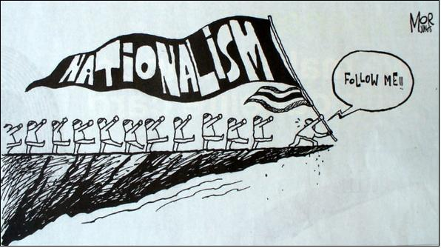
Interpret the source: What does this cartoon say about nationalism?
Are there identifiable symbols in the cartoon?
Is there a positive or negative connotation to this political cartoon?
What’s the message?

Slide 15
Unit 1: Alliances and Treaties
Treaty of London: 1915
Leading up to WW1 Italy was supposed to be part of the Triple Alliance. Instead, Italy stayed out of the war to wait and see how it progressed. In April, 1915, She joined the Triple Entente.
Italy’s government at the time was deadlocked. They couldn’t decide whether to join the war or stay out of the way. Some wanted to join and some didn’t. So they decided to stay out…until, Britain made them an offer they couldn’t refuse. Britain wanted Italy to join their side to strengthen the Western Front. They thought Italy could open a new front of defense.

Slide 16
They believed having Italy fighting could relieve some of the pressures elsewhere but it turned out to be a military failure.
Treaty of London: Britain offered large sections of territory in the Adriatic sea if Italy would join their side. Italy also believed if they helped win the war then they would be paid back tenfold once the Peace conference occurred. Long story short: they lost the battles they fought on the western front and so they were left behind or not given anything of worth at the conference. This angered the Italians!

Slide 17
Dual Alliance
Defensive alliance between Germany and Austria-Hungary created in 1879 as part of Bismarck’s system of alliances to prevent/limit war. Germany and A-H pledged to come to the other’s aid in case of an attack by Russia.

Slide 18
Reinsurance Treaty
A secret agreement between Germany and Russia in 1887. In this treaty they decided to remain neutral if the other became involved in a war wit another great power. This would be nullified however, if Germany attacked France or if Russia attacked Austria.
In 1890, when the treaty was not renewed, a Franco-Russian alliance began to take shape.

Slide 19
Franco-Russian alliance
1894 this occurred. When the Reinsurance treaty was not renewed, France swooped in to take Germany’s place.

Slide 20
Triple Alliance
1882 Austria-Hungary, Germany and Italy formed the TA. They promised to defend each other if either were attacked. The purpose of this alliance was to isolate France in the event of war.

Slide 21
Triple Entente
1907 France, Russia and Britain formed the TE. They did not promise to help each other but together they encircled Germany and Austria-Hungary. They formed simply in response to the rising powers of Germany and AH.

Slide 22
Economic Rivalry
In the age of imperialism, Britain and Germany became keen economic competitors. Leaders understood the economic strength was the true foundation of military and political power- hence they wanted colonies and the natural recourses and prestige that came with them.
Germanys economy was flourishing (newly unified, annexation of Alsace-Lorraine, population surge, newer factories and technology than Britain etc). For example, by 1914 they were producing twice as much steel as Britain.
The German education system with its concentration on the sciences and tech produced the engineers and scientists needed to foster Germany’s developing technology.
British industries were older and becoming less efficient, by the early 1900’s they could not keep pace with Germany.

Slide 23
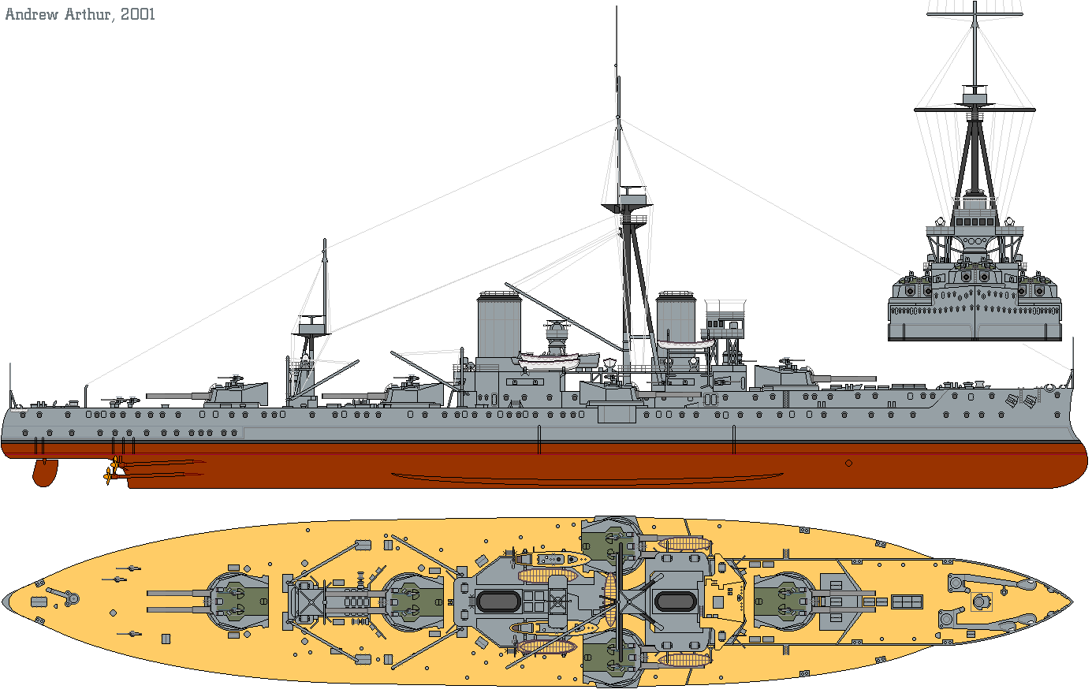
The Arms Race
From 1891 to 1919, an arms race between several European countries, including Germany, France, Russia, (as well as some other smaller countries,) took place.
British concern about rapid increase in German naval power resulted in a costly building competition of Dreadnought-class ships.
This tense arms race lasted until June 1914, when after two antagonistic power blocs were formed because of the rivalry, the World War broke out.
If it weren't for this arms Race, World War I may never have taken place, as the governments of these nations would not have felt they had the military technology and navies to risk their citizens in the war.
After the war, a new arms race developed among the victorious Allies.

Slide 24
The Balkans
Powder keg ready to explode

Slide 27
Background info
Ottoman Empire ruled over the Balkan territories. Ottoman Empire=Turkey. In the Balkans, Ethnic nationalism caused tensions to grow. Too many groups were fighting for legitimacy. (i.e., Montenegro, Bulgaria, Greece and Serbia)
The Balkans were a group of countries in Europe as shown above in previous maps.
Ottoman Empire had gained control of the Balkan states and held on until the late 1800’s-early 1900’s.

Slide 28
Because of it’s multi-ethnic composition, however, the Turks failed to assimilate the people under one umbrella/empire and this eventually led to war. (2 wars actually). There was constant unrest as the nationalists fought for power and freedom from the Turks.
Another FUN fact is that the ethnicities in each region were never big enough to be legitimated as a dominant power due to migration to other states so each group wanted to unite their people from many places.

Slide 29
As a result of this, powerful European nations like Russia, Germany, and Britain always got involved to back one ethnic group or another. #illsavetheday.
Britain -> Greeks
Russia ->Slavic people-Serbs
Habsburgs (Austria) -> Croats, Bosnians.
Whenever conflict arose (i.e., 1908 Turkish revolution), these countries and their accompanying muscle would push and shove for more land.

Slide 30
Germany, France, Russia, Austria-Hungary, and Britain attempting to keep the lid on the simmering cauldron of imperialist and nationalist tensions in the Balkans to prevent a general European war. They were successful in 1912 and 1913 but did not succeed in 1914.

Slide 31
The Balkan Summary
A-H represented the Triple Alliance and Russia represented the Triple Entente- these 2 alliances would come to a head in the Balkans and bring their respective alliance with them!
The Balkans became very important to European politics because it was a cauldron (see prev. cartoon) of aggressive competing nationalism, and a flashpoint between members for the Triple Alliance (A-H) and the Triple Entente (Russia).
SERBIA was the most significant Balkan nation because it was supported by Russia, had emerged from recent wars, and hoped to unite all Serbs (inclusing those in A-H) in a more powerful Serbian nation

Slide 32
Germany’s Blank Cheque to Austria
July 6th 1914, just a few days after the assassination of Archduke Franz Ferdinand (June 28th), Austria sends a note to Germany’s Kaiser Wilhelm II explaining what happened and asking Germany’s advice. Germany responds by saying that they will support whichever action Austria decides to take against Serbia. This is known as Germany’s blank cheque to Austria.

Slide 33
Timeline of major steps to WW1
1. Archduke Franz Ferdinand is assassinated in Sarajevo by a member of the Serbian nationalist terrorist group the Black Hand
2. Austria gives Serbia a 48 hour ultimatum (Serbia rejects and mobilizes)
3. Austria declares war on Serbia (Serbia asks Russia to help so Russia gets ready to fight)
4. Germany declares war on Russia (after asking them to not get involved which they ignore)

Slide 34
Timeline of major steps to WW1
5. Germany invades Belgium (Schlieffen plan) in order to attack France because France jumps in to help Russia.
6. Germany declares war on France
7. Britain declares war on Germany (for having invaded their ally, Belgium)

Slide 35
German and British attitudes on the eve of WWI
Kaiser Wilhelm II wanted a world class navy comparable to Great Britain. This led to tensions between Germany and Britain and an eventual arms race. This is when Britain came out with their new class of battleships, the Dreadnought.
Germany, historically, had no need for a navy, being largely a land based power. When the Kaiser came to power in 1888, he changed Germany‘s foreign policy to acquire an empire and a world class navy to do it.
This led to increased tensions and an arms race (naval in nature) between the two countries.

Slide 36
Because of this arms race, Britain created an alliance with France.
Britain didn’t really want to go to war but was willing to do so if it was due to threats to
a. their empire
b. it’s naval dominance, or
c. a shifting balance of power in Europe.
Germany considered war to be a natural and desirable occurrence in order to air out differences and to establish its dominance over others. This was shown when Germany offered it’s blank cheque of support to Austria after the assassination of the Franz Ferdinand.

Slide 37
Britain wish to maintain the “Status Quo”. It wanted to safeguard its legacy of being the top power and preserving the current world order.
Germany wanted to challenge such a legacy and have its “place in the sun”. Germany was motivated by a vision of change and challenge.
Germany believed that war was necessary to end European tensions, and did not think Britain would intervene to protect Belgium.
Both sides believed that WW I would be a short war.

Slide 38
Germany hoped Britain would stay out of the war altogether. However, the Germans knew that Britain had promised to defend Belgium under the Treaty of London of 1839. The Germans wanted the British government to ignore the Treaty of London and let the German army pass through Belgium. The British government made much of their duty to protect Belgium. Belgium's ports were close to the British coast and German control of Belgium would have been seen as a serious threat to Britain. In the end, Britain refused to ignore the events of 4 August 1914, when Germany attacked France through Belgium. Within hours, Britain declared war on Germany.

Slide 40
The Schlieffen Plan
This plan was devised by Alfred Von Schlieffen in 1905.
Germany came up with this plan for two reasons:
Avoid a war on two fronts where they would have to split their armies between east and west front (Russia and France respectively).
Germany assumed that Belgium would not resist invasion being a neutral country, allowing Germany to march through quickly. Germany also assumed Britain wouldn’t enter the war before the French were defeated and that the French wouldn’t have time to make it to Belgium to defend.

Slide 41
Germany figured that by knocking France out early they would be able to concentrate and defeat Russia in the east quickly and war won.
Their plan was to encircle France by entering Luxembourg, Holland and Belgium and encircling them at Alsace-Lorraine.
Britain came to France’s aid early and tore through the German advances.
The plan was a failure. The enemy had figured out the trap and moved into the east (Marne) instead of the west of Paris. Marne and Schlieffen were failures for the Germans and the allies won.
Battles of the Marne 1914: This battle took place in September, 1914 after the Germans had advanced into France under the Schlieffen Plan. An Allied line of defence was established along the River Marne north of Paris. As the Germans advanced, the Allied forces held and launched a counterattack. This stalled the German offensive and both sides dug their line of trenches and settled in for a long war of attrition

Slide 42
The Schlieffen Plan Video
https://www.youtube.com/watch?v=lHeMPV5VDR4

Slide 43
Plan XVII
Plan XVII was the name of a "scheme of mobilization and concentration" adopted by the French General Staff from 1912–1914, to be put into effect by the French Army in the event of war between France and Germany.
The French knew of the Schlieffen Plan prior to 1914 but they doubted Germanys ability to implement it.
This was France’s “short war plan” which called for a quick and devastating attack on Alsace-Lorraine. After recapturing these provinces they would advance on Berlin and crush the German army between themselves and the Russians.
The plan was implemented from 7 August 1914, with disastrous consequences for the French, who were defeated in the Battle of the Frontiers at a cost of 329,000 casualties.
The French northern armies were forced into a retreat as far as the Marne river, where in the First Battle of the Marne (5–12 September), the German armies were defeated and forced back to the Aisne river.

Slide 44
The Nations prepare for a much longer war than first expected…..

Slide 45
Instead of a short war, WWI becomes the war of attrition
Attrition warfare is a military strategy in which one attempts to win by wearing down the enemy to the point of collapse through continuous losses in personnel and materiel.
The war will usually be won by the side with greater such resources
It is usually a long, drawn out process
A war not of quick decisive battles, but a war of who has the men and the resources to keep their armies going the longest.

Slide 46
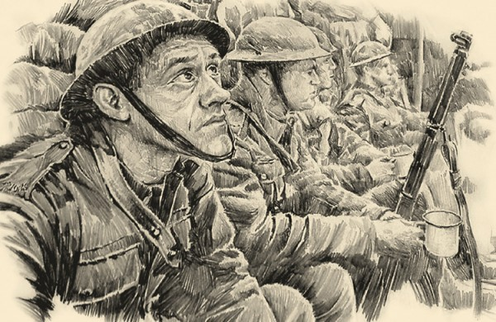
Trench Warfare

Slide 47
Trench warfare creates a stalemate on the Western Front
Pretty simple, after the race to the sea, armies began to dig in trenches to hold their line. The area between trenches called “no mans land” was deadly, full of barbed wire, explosives, and enemy fire (guns and tanks behind enemy lines). As the trench system became more elaborate and expansive it was easy for armies to wait for an enemy attack, because going “over the top” to begin your own offensive almost always ended badly. Armies on both sides made very few territorial advances throughout the war, this is known as a stalemate.

Slide 48
Stalemate on the Western Front
From the end of 1914 to 1918, there was a stalemate on the Western Front. Neither side could gain any real territory or victory since no side could break through the other’s defenses.
The basic strategy of the time was to have infantrymen attack the enemy line by attacking the gaps in their defenses.
Trenches on both sides were protected by sandbags and barbed wire, and once new technologies like the machine gun were used, this type of advance proved impossible and men were “mowed down” in NML.

Slide 49
Stalemate on the Western Front
Military commanders on the Western Front were considered the best in their fields, BUT they were not so familiar with trench warfare. They were used to old tactics and cavalry-style fighting, and were unprepared for a stalemate and knew little on how to break it.
Many new technologies were developed at this point (machine guns/chlorine gas)but commanders had little knowledge of how to effectively use it and were slow to equip their men with these technologies.
Their belief at the time was that quantity (of men)was better than quality of weapons, and that sending huge numbers of infantry soldiers would achieve a breakthrough against machine guns and barbed wire. Turns out they were wrong, and this led to massive numbers of casualties on the Western front.

Slide 50
Trench Warfare
https://www.youtube.com/watch?v=_G4ZY66BG38 (short video- 3min)
https://www.youtube.com/watch?v=0LO1dYuI6g0 (Digging Up The Trenches (Battle Of The Somme Documentary) - Real Stories

Slide 51
Check out this site on trench warfare!
http://www.firstworldwar.com/features/trenchlife.htm
Life in the trenches: Daily Death in the Trenches: Death was a constant companion to those serving in the line, even when no raid or attack was launched or defended against.
Rat Infestation: Rats in their millions infested trenches. There were two main types, the brown and the black rat. Both were despised but the brown rat was especially feared. Gorging themselves on human remains (grotesquely disfiguring them by eating their eyes and liver) they could grow to the size of a cat.
Frogs, Lice and Worse: Rats were by no means the only source of infection and nuisance. Lice were a never-ending problem, breeding in the seams of filthy clothing and causing men to itch unceasingly.
The Trench Cycle; Typically, a battalion would be expected to serve a spell in the front line. This would be followed by a stint spent in support, and then in reserve lines. A period of rest would follow - generally short in duration - before the whole cycle of trench duty would start afresh.

Slide 52
Stand To and the Morning Hate: The daily routine of life in the trenches began with the morning 'stand to'. An hour before dawn everyone was roused from slumber by the company orderly officer and sergeant and ordered to climb up on the fire step to guard against a dawn raid by the enemy, bayonets fixed. Accompanying stand to, as the light grew, was the daily ritual often termed the 'morning hate'. Both sides would often relieve the tension of the early hours with machine gun fire, shelling and small arms fire, directed into the mist to their front: this made doubly sure of safety at dawn.
Rum, Rifles and the Breakfast Truce: With stand to over, in some areas rum might then be issued to the men. They would then attend to the cleaning of their rifle equipment, which was followed by its inspection by officers.
Inspection and Chores: With breakfast over the men would be inspected by either the company or platoon commander. Once this had been completed NCOs would assign daily chores to each man (except those who had been excused duty for a variety of reasons).Example - and necessary - daily chores included the refilling of sandbags, the repair of the duckboards on the floor of the trench and the draining of trenches.

Slide 53
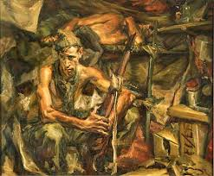

Slide 54
Trench Warfare

Slide 55
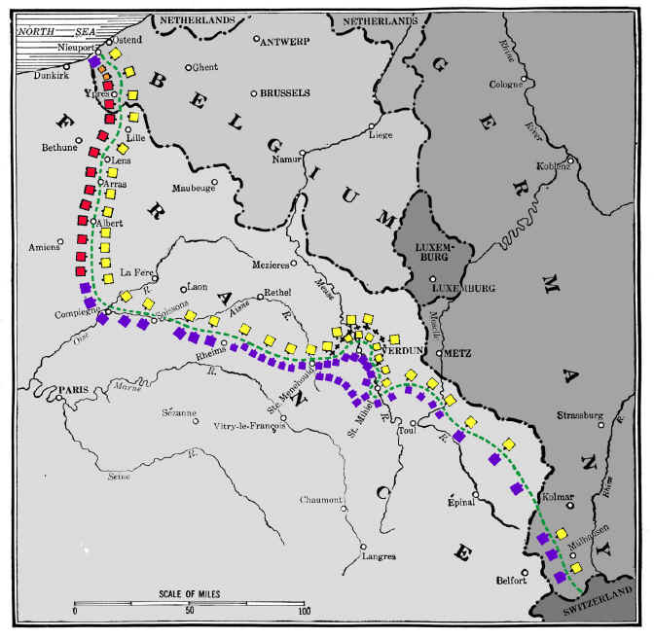
Western Front: North Sea (Belgium)to Switzerland

Slide 56
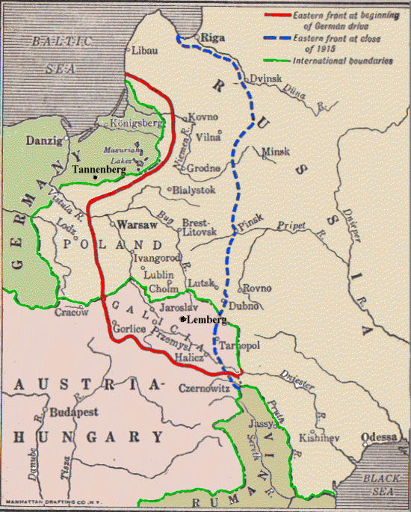
Eastern Front: Baltic Sea to Black Sea

Slide 57
Daily Boredom: Given that each side's front line was constantly under watch by snipers and look-outs during daylight, movement was logically restricted until night fell. Thus, once men had concluded their assigned tasks they were free to attend to more personal matters, such as the reading and writing of letters home.
Dusk: Stand To, Supply and Maintenance: With the onset of dusk the morning ritual of stand to was repeated, again to guard against a surprise attack launched as light fell.
Patrolling No Man's Land: Patrols would often be sent out into No Mans Land. Some men would be tasked with repairing or adding barbed wire to the front line. Others however would go out to assigned listening posts, hoping to pick up valuable information from the enemy lines.

Slide 58
Relieving Men at the Front: Men were relieved front-line duty at night-time too. Relieving units would wind their weary way through numerous lines of communications trenches, weighed down with equipment and trench stores (such as shovels, picks, corrugated iron, duckboards, etc.). The process of relieving a line could take several frustrating hours.
The Smell: no overview of trench life can avoid the aspect that instantly struck visitors to the lines: the appalling reek given off by numerous conflicting sources. Rotting carcasses lay around in their thousands. For example, approximately 200,000 men were killed on the Somme battlefields, many of which lay in shallow graves.
Men who had not been afforded the luxury of a bath in weeks or months would offer the pervading odour of dried sweat. The feet were generally accepted to give off the worst odour.
Trenches would also smell of creosol or chloride of lime, used to stave off the constant threat of disease and infection.
Add to this the smell of cordite, the lingering odour of poison gas, rotting sandbags, stagnant mud, cigarette smoke and cooking food... yet men grew used to it, while it thoroughly overcame first-time visitors to the front.

Slide 59
Major Battles

Slide 60
Battle of the Marne 1914
7–12 September 1914
It resulted in an Allied victory against the German Army.
The battle was the culmination of the German advance into France and pursuit of the Allied armies and had reached the eastern outskirts of Paris.
A counter-attack by six French field armies and the British Expeditionary Force (BEF) along the Marne River forced the Imperial German Army to retreat north-west, leading to the Battle of the Aisne and the "Race to the Sea".
The Battle of the Marne was a victory for the Allies, but it also set the stage for four years of trench warfare stalemate on the Western Front.

Slide 61
Battle of Tannenberg
26-30 August 1914
Between Russia and Germany
The battle resulted in the almost complete destruction of the Russian Second Army and the suicide of its commanding general, Alexander Samsonov.
Perhaps the most spectacular and complete German victory of the First World War, the encirclement and destruction of the Russian Second Army in late August 1914 virtually ended Russia's invasion of East Prussia before it had really started.
A series of follow-up battles (First Masurian Lakes) destroyed most of the First Army as well and kept the Russians off balance until the spring of 1915.
The battle is particularly notable for fast rail movements by the Germans, enabling them to concentrate against each of the two Russian armies in turn, and also for the failure of the Russians to encode their radio messages.

Slide 62
Battle of Tannenberg (artistic representation)

Slide 63
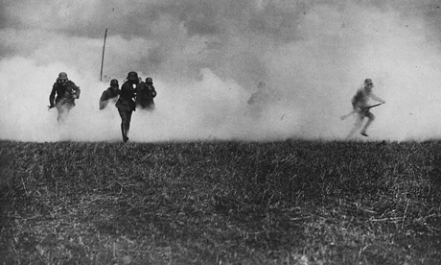
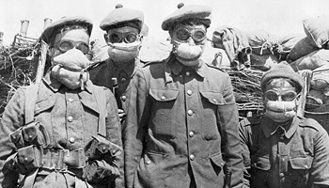
Battle of Ypres
April- May 1915
In the first week of April 1915, the Canadian troops were moved from their quiet sector to the front lines. The Germans held the higher ground and were able to fire into the Allied trenches from the north, the south and the east.
April 22 the Germans introduced a new weapon, poison gas.
Following an intensive artillery bombardment, they released 160 tons of chlorine gas from cylinders dug into the forward edge of their trenches into a light northeast wind.
Thick clouds of yellow-green chlorine drifted over their trenches the French defences crumbled, and the horrified and suffering troops died or broke and fled, leaving a gaping 6.5 kilometre hole in the Allied line.
German troops pressed forward, threatening to sweep behind the Canadian trenches and put 50,000 Canadian and British troops in deadly jeopardy. Fortunately the Germans had planned only a limited offensive and, without adequate reserves, were unable to exploit the gap the gas created. Their own troop also lacked adequate protection against gas. After advancing only 3.25 kilometres they stopped and dug in
Canadians won against German attacks but withdrew in may
German win

Slide 64
Battle of the Somme
Began on July 1st 1916 (lasted 4 months)
Planned French and British offensive
Both army leaders (Marshall Joffre for the French and Douglas Haig for the British) who believed that the best offensive was to wear down the enemy (attrition) they wanted to attack constantly until the Germans would surrender.
The best place to attack the Germans would be where both armies met at the River Somme

Slide 65
Somme failure for the Allies
This attack was no surprise to the Germans and they were ready. (good luck message sent from officers to British troops was intercepted by Germans)
The strategy was to use planes to spot enemy artillery positions and destroy them making way for soldiers on foot but clouds made it difficult for pilots to see.
Thousands of troops were to storm no mans land in groups and cut through enemy wire and destroy German trenches BUT these troops were quickly shot down before getting across NML.
The Somme region was the strongest part of German defences as they had dugouts 10 metres deep that saved them from bombardments.

Slide 66
Despite the 20,000 killed and 40,000 wounded on the first day, haigrefused to call it all off.
Tanks were used for the first time during this battle.
Battle ended in November as a result of bad weather.
Beaumont-Hamel occurredduring this battle.
The main reason for this battle was to distract the Germans from the Verdun battle and force their reserve armies into battle

Slide 67
Battle of Beaumont Hamel
1 July 1916
Allied forces launched a major offensive in France on the opening of the Somme offensive.
It turned into one of the deadliest days in the history of modern warfare.
The Germans were deeply entrenched at Beaumont-Hamel. In the days leading up to the “Big Push” on the opening of the offensive, Allied commanders repeatedly bombarded the German lines with artillery — attacks they hoped would severely damage enemy fortifications. But at 7 a.m., on 1 July 1916, when the first wave of Allied soldiers went over the top of their trenches and into no man's land, the Germans were ready and waiting, having largely survived the artillery bombardment.
The battlefield at Beaumont-Hamel soon became littered with hundreds of dead and dying Allied soldiers. Yet, the commanders decided to press on. At 9:15 a.m. the Newfoundlanders were ordered to attack from their trench behind the front line, nicknamed St. John's Road. Weighed down by backpacks weighing almost 30 kg, and having to move across open ground in full view of German machine guns and artillery, the soldiers of the First Newfoundland Regiment were slaughtered in an attack lasting less than 30 minutes.

Slide 68
Battle of Beaumont Hamel
At the village of Beaumont-Hamel, the First Newfoundland Regiment suffered catastrophic losses. After a battle lasting only 30 minutes, less than 10 per cent of the regiment was able to answer roll call.
The losses were devastating. Of the 801 soldiers of the First Newfoundland Regiment only 68 were able to answer roll call following the battle. More than 700 were killed, wounded or missing in action. The dead included several sets of brothers.
Despite its staggering losses, the First Newfoundland Regiment regrouped with fresh troops from home, and would go on to fight in several important battles of the war, at Guedecourt, Ypres, Arras, Courtrai and Cambrai
At Beaumont-Hamel, the battlefield is now a park. At its highest point a statue of a caribou, the official emblem of the Royal Newfoundland Regiment, looks out over the field where so many died. Their names fill three brass plaques at the base of the monument.

Slide 69
Trench at Beaumont Hamel
A pathway leads down one of the former trenches used by soldiers of the Royal Newfoundland Regiment, at the Beaumont Hamel battlefield in France.

Slide 70
Passchendaele
July-November 1917
A major campaign fought by the Allies against the German Empire. The battle was for control of the ridges south and east of the Belgian city of Ypres in West Flanders.
Passchendaele lay on the last ridge east of Ypres, 5 miles (8.0 km) from a railway junction at Roulers, which was vital to the supply system of the German Army.
The Battle of Passchendaele is a vivid symbol of the mud, madness and the senseless slaughter of the First World War. In the late summer of 1917, the British launched a series of failed assaults against German forces holding the plateau overlooking the city of Ypres, Belgium. The battlefield became a quagmire.
Canadian forces entered the fray in October, capturing the Passchendaele ridge at a cost of 15,600 casualties — a high price for a piece of ground that would be vacated for the enemy the following year.

Slide 71
Wounded Canadians on their way to an aid-post.
Battle of Passchendaele, November 1917

Slide 72
Battle of Vimy Ridge
April 1917
Expected German victory
Canadian win-Allied win
The main combatants were the Canadian Corps, of four divisions, against three divisions of the German Sixth Army.
The objective of the Canadian Corps was to take control of the German-held high ground along an escarpment. This would ensure that the southern flank could advance without suffering German fire. Supported by a creeping barrage, the Canadian Corps captured most of the ridge during the first day of the attack.
The town of Thélus fell during the second day of the attack, as did the crest of the ridge once the Canadian Corps overcame considerable German resistance. The final objective, a fortified knoll located outside the village of Givenchy-en-Gohelle, fell to the Canadian Corps on 12 April. The German forces then retreated.

Slide 73
Historians attribute the success of the Canadian Corps in capturing the ridge to a mixture of technical and tactical innovation, meticulous planning, powerful artillery support and extensive training, as well as the failure of the German Sixth Army to properly apply the new German defensive doctrine.
The battle was the first occasion when all four divisions of the Canadian Expeditionary Force participated in a battle together and it was made a symbol of Canadian national achievement and sacrifice
The Battle of Vimy Ridge,
painting by Richard Jack. Canadian War Museum.

Slide 74
2nd Battle of the Marne 1918
The Second Battle of the Marne marked the turning of the tide in World War I.
It began with the last German offensive of the conflict and was quickly followed by the first allied offensive victory of 1918.
The American Expeditionary Force with over 250,000 men fighting under overall French command played key roles both in the initial defense and the later advances. In the Second Battle of Marne with 30,000 killed and wounded, the United States started suffering casualties on the enormous scale usually associated with the battles of the Great War.

Slide 75
The Russians Leave the War

Slide 76
Treaty of Brest-Litovsk
March 1918
Vladimir Lenin, leader of the Bolsheviks and the 1st communist leader of Russia, negotiated peace talks with Germany.
He knew the war was costing Russia way more than they could afford and they were losing anyway.
Lenin knew that if he put an end to their involvement, he could win the support of the army and the people of Russia which would assure his stay in power.
Lenin and the Bolsheviks (“The Reds”) promised the people “Peace, Land, and Bread”

Slide 77
Negotiations were:
Russia would be permitted to end their participation in the war and bow out To do this, however, they had to give up their richest areas to Germany
26% of its population
27% of their best farmland in Russia
26% of their railways
74% of their iron ore and coal
The people were very angry with Lenin for settling on these terms but Lenin assured them that it was a gamble since he believed that Germany would soon fall into a revolution itself and the treaty would then be broken. Lenin’s gamble did pay off but for different reasons. Germany was defeated on the Western Front later in 1918 and agreed to an armistice in November of that year.

Slide 78
WWI: Technology

Slide 79
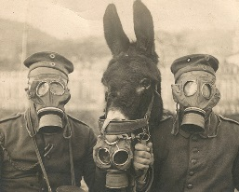
Technology: Gas
First used by Germans during Ypres in April 1915.
Greenish yellow cloud that changed to bluish white mist.
Urinating on rags when there were no masks did not work.
The weather (wind directions) really impacted effectiveness.
Released from cylinders when wind was blowing in right direction.

Slide 80
Cylinders were first used and later gas shells were introduced. These gases were lung irritants and later nervous system attackers. First used was chlorine gas then mustard gas.
Mustard gas was like an acid, an odourless colourless gas.
Later in war they stopped using gas as it was unpredictable and both sides developed gas masks.

Slide 81
Technology 2: Tanks
Most original invention of war.
Used for first time during Battle of the Somme.
Most of them regularly broke down, got stuck or ran out of gas quickly.
Haig (British commander)said no thanks to using them. The Germans however, sank lots of money into its creation.
The 1st was “Big Willie” it carried 20 men at a time. It could climb a 5 foot slope, travel 6 km/h, reverse, cross an 8 ft gap.

Slide 82
The tanks were unsuccessful until 1918 because they were:
Unreliable, tracks came off easily, got stuck, engine stopped for no reason.
They were primarily best for protecting infantry but not used that way at first. They were usually successful penetrating enemy lines but ended up having to return to their own trenches because there were no men outside the tanks to protect those inside.

Slide 83
Technology 3: Machine Guns
Could fire up to 600 bullets a minute.
Used throughout WWI mainly by Germans (in the beginning).
Weighed approx 40 llbs on the tripod.
Took up to 5 men to operate.
Were effective in “mowing” down the enemy in NML and reinforced the stalemate on the Western front.

Slide 84
Technology 4: Aircraft and Aircraft Carriers
As with most other technologies, the aircraft underwent many improvements during World War I.
While early air spotters were unarmed, they soon began firing at each other with handheld weapons. An arms race commenced, quickly leading to increasingly agile planes equipped with machine guns. A key innovation was the interrupter gear, a Dutch invention[2] that allowed a machine gun to be mounted behind the propeller so the pilot could fire directly ahead, along the plane's flight path.
As the stalemate developed on the ground, with both sides unable to advance even a few miles without a major battle and thousands of casualties, planes became greatly valued for their role gathering intelligence on enemy positions and bombing the enemy's supplies behind the trench lines.
The first time an airplane was launched from a moving ship was in May 1912. However it wasn’t a true aircraft carrier, since planes couldn’t land on its deck; they had to set down on the water and then be retrieved, slowing the whole process considerably.
The first real aircraft carrier was the HMS Furious, which began life as a 786-foot-long battle cruiser equipped with two massive 18-inch guns—until British naval designers figured out that these guns were so large they might shake the ship to pieces. Looking for another use for the vessel, they built a long platform capable of both launching and landing airplanes. To make more room for takeoffs and landings, the airplanes were stored in hangars under the runway, as they still are in modern aircraft carriers.
Squadron Commander Edward Dunning became the first person to land a plane on a moving ship when he landed on the Furious on August 2, 1917.

Slide 86
Technology 5: Submarines
World War I was the first conflict in which submarines were a serious weapon of war.
The United Kingdom relied heavily on imports to feed its population and supply its war industry, and the German Navy hoped to blockade and starve Britain using U-boats to attack merchant ships in unrestricted submarine warfare.
This struggle between German submarines and British counter measures became known as the "First Battle of the Atlantic". As German submarines became more numerous and effective, the British sought ways to protect their merchant ships.
Consolidating merchant ships into convoys protected by one or more armed navy vessels was adopted later in the war. There was initially a great deal of debate about this approach, out of fear that it would provide German U-boats with a wealth of convenient targets. Thanks to the development of active and passive sonar devices, coupled with increasingly deadly anti-submarine weapons, the convoy system reduced British losses to U-boats to a small fraction of their former level.

Slide 87
Weapons of war (1914-1918)
http://firstworldwar.com/weaponry/machineguns.htm

Slide 88
War on the 2 Fronts
Eastern Front
For four years, the Germans, Russians, and Austro-Hungarians fought a war of movement.
Rapid movement and concentration resulted in stunning “cauldron battles;” tactical and technical developments led to large-scale breakthroughs and advances (or retreats) of hundreds of miles.
On the Eastern Front, as on the Western, the conflict dragged on for years, with neither side truly able to deliver a knock-out blow.
The German Army's Spring Offensive of 1918 was made possible by the Treaty of Brest-Litovsk that marked the end of the conflict on the Eastern Front
Western Front
The Western Front was the main theatre of war during World War I.
Following the initial race to the sea, both sides dug in along a meandering line of fortified trenches, stretching from the North Sea to the Swiss frontier with France. This line remained essentially unchanged for most of the war.
Between 1915 and 1917 there were several major offensives along this front. However, a combination of entrenchments, machine gun nests, barbed wire, and artillery repeatedly inflicted severe casualties on the attackers and counter-attacking defenders. As a result, no significant advances were made
In an effort to break the deadlock, this front saw the introduction of new military technology, including poison gas, aircraft and tanks. But it was only after the adoption of improved tactics that some degree of mobility was restored.

Slide 89
“In the west, the armies were too big for the land; in the east, the land was too big for the armies.”
Winston Churchill (1874-1965)

Slide 90
The US Enters the war….game changer!
The United States entered the war because of the Germans' decision to resume the policy of unrestricted submarine warfare, and the so-called "Zimmerman telegram," intercepted by the British, in which Germany floated the idea of an alliance with Mexico.

Slide 91
Sinking of the Lusitania

Slide 92
Zimmerman Telegram

Slide 93
WWI: Impact on Canada
Social (change in the status of women)
Economic (stimulation of Canadian industry)
Political (greater Canadian role in international relations)

Slide 94
Social (change in the status of women)
In 1917, amidst the tremendous reconfiguration of labour practices on the home front, the movement for women’s suffrage won a major victory with the passage of the Wartime Elections Act, which granted some women the right to vote in federal elections. Suffrage at this time was limited to women working in the armed forces and the wives, mothers and sisters of soldiers overseas.
During the First and Second World Wars women entered the munitions industry en masse. According to the Imperial Munitions Board, about 35,000 women worked in munitions factories in Ontario and Québec during the First World War.
Women also worked to ensure a thriving home economy. During the First and Second World Wars, they produced and conserved food; raised funds to finance hospitals, ambulances, hostels and aircraft; and volunteered their services inside and outside the country. Many women also joined such public service organizations as the Federated Women's Institutes of Canada, the Imperial Order Daughters of the Empire, the Young Women's Christian Association and the Canadian Red Cross Society.
Whatever the conventional role for women in the social order, war required the full scope of Canada’s human resources. At the same time, the temporary nature of women's contributions during the First and Second World Wars ensured that their wartime efforts did not challenge the established system and that they reverted to conventional female roles after hostilities ended. In war, women's labour was essential, but in peace it was expendable.
Despite women’s contributions to Canada’s military efforts in the 20th century, they were not allowed full entry into the armed forces until the late 1980s

Slide 95
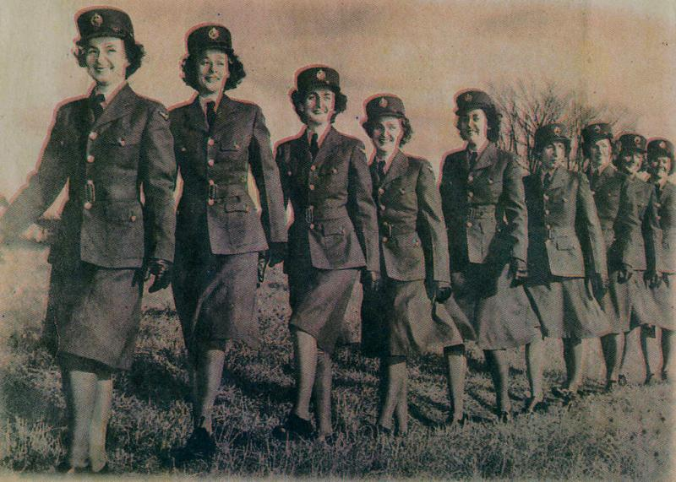
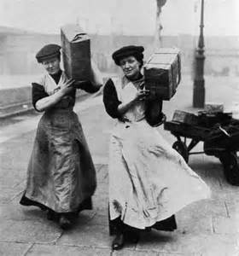
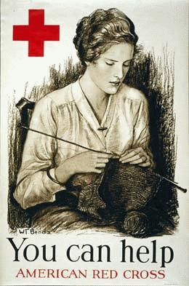
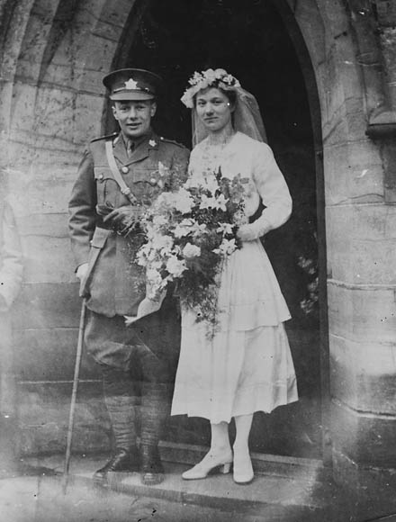
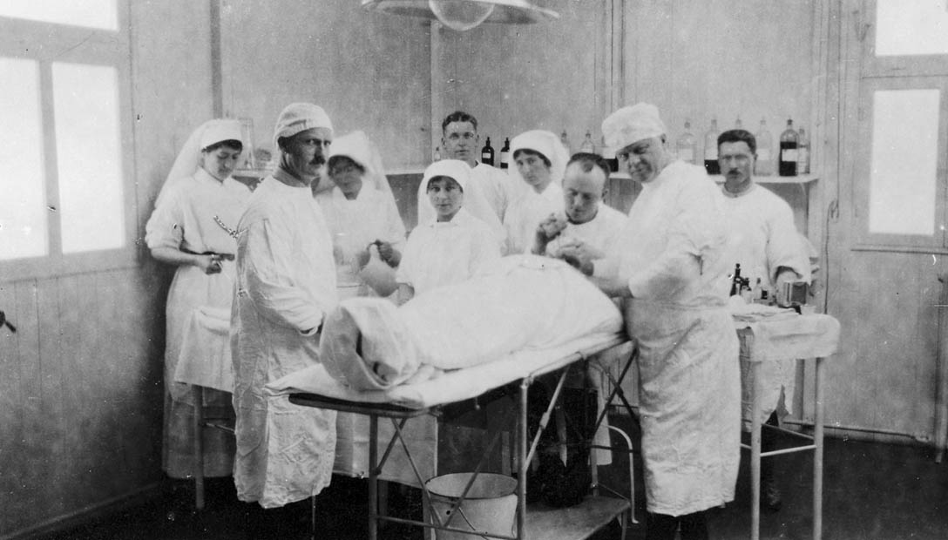

Slide 96
Economic (stimulation of Canadian industry)
At first the war hurt a troubled economy, increasing unemployment and making it hard for Canada's new, debt-ridden transcontinental railways to find credit. Far from ending the pre-war economic recession, the war’s outbreak at first worsened it, with layoffs, contract cancellations, and severe cutbacks in the already-troubled railway industry.
By 1915 military spending equaled the entire government expenditure of 1913. Minister of Finance Thomas White opposed raising taxes. Since Britain could not afford to lend to Canada, White turned to the US.
Also, despite the belief that Canadians would never lend to their own government, White had to take the risk. In 1915 he asked for $50 million; he got $100 million. In 1917 the government's Victory Loan campaign began raising huge sums from ordinary citizens for the first time. Canada's war effort was financed mainly by borrowing. Between 1913 and 1918 the national debt rose from $463 million to $2.46 billion.
Canada's economic burden would have been unbearable without huge exports of wheat, timber and munitions. A prewar crop failure had been a warning to prairie farmers of future droughts, but a bumper crop in 1915 and soaring prices banished caution. Since many farm labourers had joined the Army, farmers began to complain of a labour shortage. It was hoped that factories shut down by the recession would profit from the war.

Slide 98
Political (greater Canadian role in international relations)
Canada emerged from the First World War a proud, victorious nation with newfound standing in the world. It also emerged grieving and divided, forever changed by the war’s unprecedented exertions and horrific costs.
61,000 Canadians were dead. Many more returned from the conflict mutilated in mind or body. The survivors found that almost every facet of Canadian life, from the length of skirts to the value of money, had been transformed by the war years.
Overseas, Canada's soldiers had struggled to achieve, and had won, a considerable degree of autonomy from British control.
Canada's direct reward for her sacrifices was a presence at the Versailles conference and a seat in the new League of Nations.
Despite the social and political challenges of the post-war, most Canadians also emerged from the struggle believing they had done important and difficult things together. Their primary fighting force at the front, the Canadian Corps, had achieved a first-class reputation as one of the most effective formations on the Western Front. Their generals and politicians had played an obvious role in victory, and the country itself enjoyed an international standing that few observers in 1914 could have predicted.

Slide 99
The Cost of WWI
10 Million lives lost
Financial costs estimated at $180 billion and another $150 billion in indirect costs.
The crumbling of 4 great empires (Hohenzollern Germany; Hapsburg Austria-Hungary; Romanov Russia and Ottoman Turkey)
Much of Europe (particularly the Western Front- France and Belgium were destroyed by the 4 years of trench warfare).
Europeans were traumatized

Slide 100
Responsibility of WWI
Who do you think is responsible for causing WW1?
Why do you think they are responsible? What evidence can you cite?

Slide 101
“He (Kaiser Wilhelm II) has ruined his country. I look upon him as the greatest criminal known for having plunged the world into this ghastly war which has lasted for over 4 years and 3 months with all its misery” -King George V of Great Britain, Nov. 1918.
Because Kaiser Wilhelm was the leader of Germany, many people blamed him and they believed he should be held responsible for causing WW1.

Slide 102
There are 2 OBVIOUS choices when answering this question. You can choose GERMAN or COLLECTIVE responsibility.
Collective:
Nationalism, alliances, arms race, economic rivalry (militarism and imperialism)
All major nations sought the above and therefore should share blame
They all believed it would be a short war so why not fight it out and see who comes out on top
British vs. Germans and their attitudes causing conflict
Technological developments like the dreadnought vs submarines
Assassination of the Archduke Franz Ferdinand (also bringing other nations into the racket)
Balkans (conflicts)

Slide 103
German
Schlieffen Plan (dragging other nations into the fight)
Zimmerman Telegram
Blank Cheque to Austria-Hungary
German expansion of its navy as a means for growth (led to GB feeling threatened and making them expand their arms even further)
“To protect Germany’s sea trade and colonies… Germany must have a battle fleet so strong that even for the adversary with the greatest sea power, a war against Germany would involve such dangers as to hurt its own position in the world.”
-Quote from the Second German Naval Law, June 1900

Slide 104
Wilson’s Fourteen Points
1. Woodrow Wilson of U.S.A- No more secret agreements ("Open covenants openly arrived at").
2. Free navigation of all seas.
Removal of economic barriers between nations.
Countries were to reduce armaments to no more than what was needed for domestic security
Decisions regarding the colonies should be made by impartial arbitrators in the interest of the colonies
6. German Army to withdraw from Russia and Russia left to determine her own political future
7. Belgium should be independent like before the war.

Slide 105
All French territory should be freed and restored. Alsace-Lorraine returned to France
The borders of Italy readjusted to align with recognizable lines of nationality
People of Austria-Hungary be allowed to be autonomous and determine their new government.
Romania, Serbia and Montenegro to be evacuated and Serbia given free access to the sea.
Turks in the Ottoman Empire rule given secure sovereign rule, but other nationalities allowed autonomy
Poland should be an independent state and allowed free and secure access to the sea
An association of Nations must be formed so that countries big and small can be policed and monitored and the world can be made safe for democracy. (the League of Nations)

Slide 106
Paris Peace Conference
Georges Clemenceau (French Premier) wanted to punish Germany and limit their power to make war in the future.
France had two basic goals:
1. National Security
- a weak Germany would ensure security.
- demanded return of Alsace-Lorraine.
- demanded that they receive the German Rhineland to serve as a buffer zone between Germany and France.
2. Financial Reparations
Clemenceau demanded that Germany pay full reparations for war damages with no time limit being placed on how long they would have to repay the amount owed.
Key concern was security of sea lanes to its empire (this meant German sea power had to be crippled).
Lloyd George (British Prime Minister) was concerned that a harsh treaty might lead Germany to wanting revenge in the future (another war). He tried to work out a compromise of the French demands
Also feared the spread of Bolshevism (Communism) into Europe from Russia. If Germany was weakened too much it could fall into the hands of Communist Russia.
- Britain’s position was somewhat “softer” on Germany than was France’s.

Slide 107
What does this political cartoon suggest about the nature and fairness of the Paris Peace Conference?
Who has power?
Who is being treated unfairly?
What role does each country play?
What does “Cannon Fodder” mean?

Slide 108
The Treaty of Versailles
Germany had to pay Reparations for the damages done by the war
Germany to return the provinces of Alsace and Lorraine to France
Germany had to turn over resources from the Saar Basin until reparations were paid
Germany was to be forever limited to no more than 100 000 soldiers in its Military
Germany could not have an air force
Germany's navy was limited to small ships only
Germany could not place troops in the Rhineland (Germany land near French border)
Germany could never again unite with Austria

Slide 110
Was it a just treaty?
Why or Why not?

Slide 111
The League of Nations

Slide 112
The League of Nations
The League of Nations was an intergovernmental organisation founded on 10 January 1920 as a result of the Paris Peace Conference that ended the First World War.
It was the first international organisation whose principal mission was to maintain world peace.
Its primary goals, as stated in its Covenant, included preventing wars through collective security and disarmament and settling international disputes through negotiation and arbitration.

Slide 113
Hall of Mirrors in Versailles where the Peace treaty was signed

Slide 114
The Impact of the Treaty of Versailles on Germany
By 1919 Germany was no longer the second most economically advanced nation in the world.
The immediate economic consequences of the terms of the Treaty of Versailles were a significant concern and added to Germany's humiliation.
Under the terms of the treaty Germany had to pay huge sums in reparations.

Slide 115
Germany was viewed as the chief instigator of the conflict.
Forced Germany to concede territories to Belgium, Czechoslovakia, and Poland. The Germans returned Alsace and Lorraine to France.
All German overseas colonies became League of Nation Mandates.
The treaty demanded demilitarization and occupation of the Rhineland.
Perhaps the most humiliating portion of the treaty for defeated Germany was Article 231, commonly known as the "War Guilt Clause," which forced the German nation to accept complete responsibility for initiating World War I. As such Germany was liable for all material damages, and France's premier Georges Clemenceau particularly insisted on imposing enormous reparation payments. Aware that Germany would probably not be able to pay such a towering debt, Clemenceau and the French nevertheless greatly feared rapid German recovery and the initiation of a new war against France. Hence, the French sought in the postwar treaty to limit Germany's potential to regain its economic superiority and to rearm.
The German army was to be limited to 100,000 men, and conscription proscribed; the treaty restricted the Navy to vessels under 10,000 tons, with a ban on the acquisition or maintenance of a submarine fleet.
Moreover, Germany was forbidden to maintain an air force. Finally, Germany was required to conduct war crimes proceedings against the Kaiser and other leaders for waging aggressive war. The subsequent Leipzig Trials, without the Kaiser or other significant national leaders in the dock, resulted largely in acquittals and were widely perceived as a sham, even in Germany.

Slide 116
The newly formed German democratic government saw the Versailles Treaty as a “dictated peace”. Although France, which had suffered more materially than the other parties in the “Big Four,” had insisted upon harsh terms, the peace treaty did not ultimately help to settle the international disputes which had initiated World War I.
The dreadful sacrifices of war and tremendous loss of life, suffered on all sides, weighed heavily not only upon the losers of the conflict, but also upon those combatants on the winning side.
For the populations of the defeated powers—Germany, Austria, Hungary, and Bulgaria—the respective peace treaties appeared an unfair punishment, and their governments quickly resorted to violating the military and financial terms of the accords. Efforts to revise and defy the more burdensome provisions of the peace became a key element in their respective foreign policies and proved a destabilizing factor in international politics.
The war guilt clause and the limitations on the German military were particularly onerous in the minds of most Germans, and revision of the Versailles Treaty represented one of the platforms that gave radical right wing parties in Germany, including Hitler's Nazi Party, such credibility to mainstream voters in the 1920s and early 1930s. Promises to rearm, to reclaim German territory, particularly in the East, to remilitarize the Rhineland, and to regain prominence again among the European and world powers after such a humiliating defeat and peace, stoked Nationalistic sentiment and helped average voters to overlook the more radical tenets of Nazi ideology.

Slide 117
The burdensome reparations, coupled with a general inflationary period in Europe in the 1920s, caused spiraling hyperinflation of the German Reichsmark by 1923. This hyperinflationary period combined with the effects of the Great Depression (beginning in 1929) seriously to undermine the stability of the German economy, wiping out the personal savings of the middle class and spurring massive unemployment. Such economic chaos did much to increase social unrest, destabilizing the fragile Weimar Republic.
Finally, the efforts of the Western European powers to marginalize Germany through the Versailles Treaty undermined and isolated German democratic leaders. Particularly deleterious in connection with the harsh provisions of Versailles was the rampant conviction among many in the general population that Germany had been “stabbed in the back” by the “November criminals”—those who had helped to form the new Weimar government and broker the peace which Germans had so desperately wanted, but which ended so disastrously in Versailles. Many Germans forgot that they had applauded the fall of the Kaiser, had initially welcomed parliamentary democratic reform, and had rejoiced at the armistice. They recalled only that the German Left—Socialists, Communists and Jews, in common imagination—had surrendered German honor to an ignominious peace when no foreign armies had even set foot on German soil.
All this instability, hardship and demoralisation of a nation set the scene for…..

Slide 118
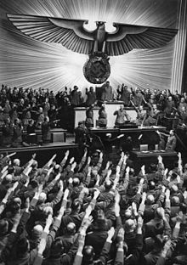
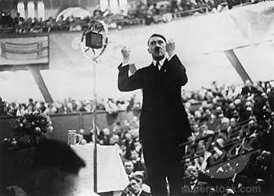
A new radical government that could return Germany to her former glory….

