Slide 1
Unit 5 (5.1) India, Africa, Egypt. Nationalism and challenges post WW2

Slide 2
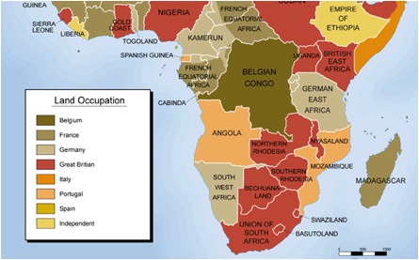
African Occupation WW1

Slide 3
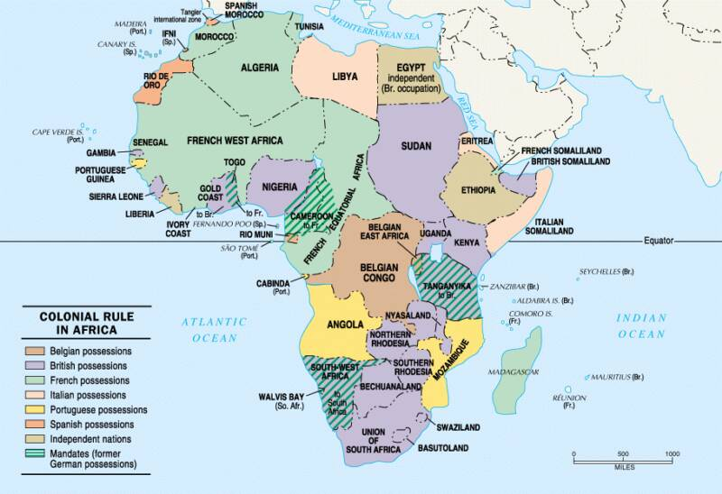
African Occupation WW2

Slide 4
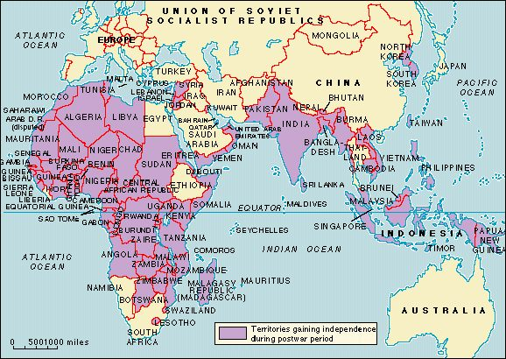
Colonies Seeking Independence Post WW2

Slide 5
What is Colonialism?
Colonialism is the establishment, exploitation and expansion of one country/territory by a political power from another territory.
Basically put: the taker-over-ers established power in Africa, Asia and the Americas and often did unspeakable things to its citizens.

Slide 6
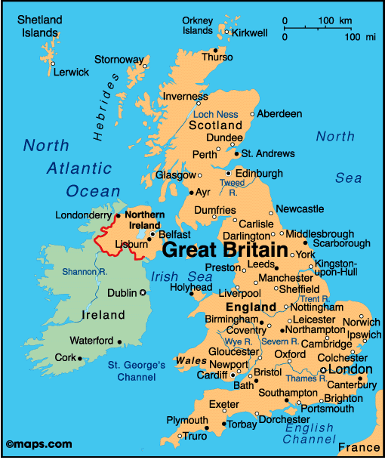
Major Colonial Powers Post WW2

Slide 7
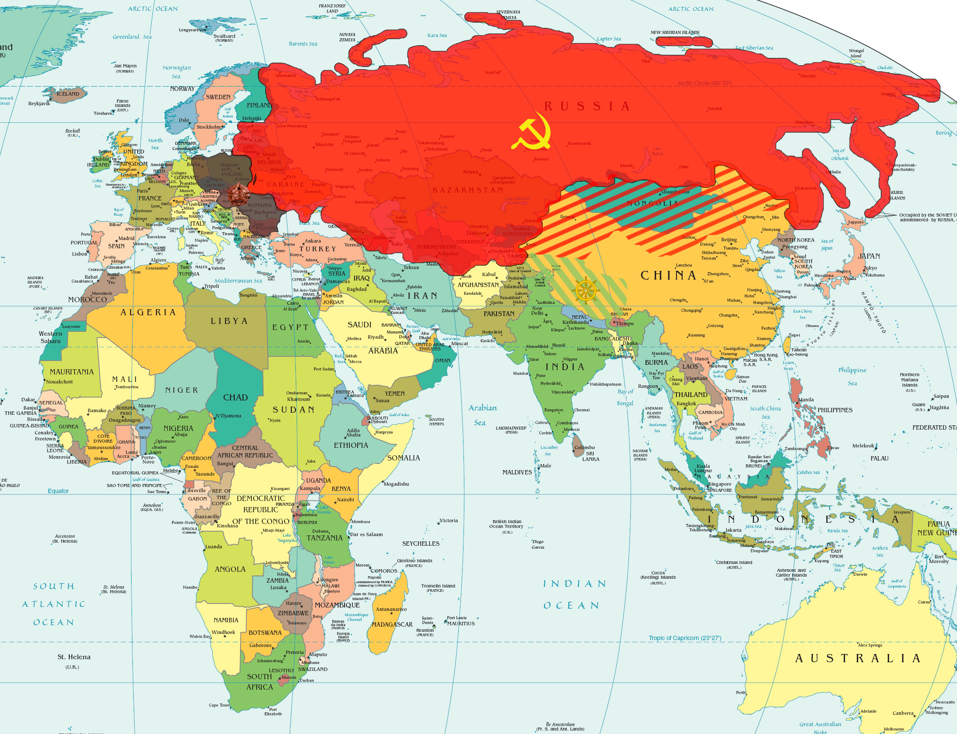
Soviet Union

Slide 8
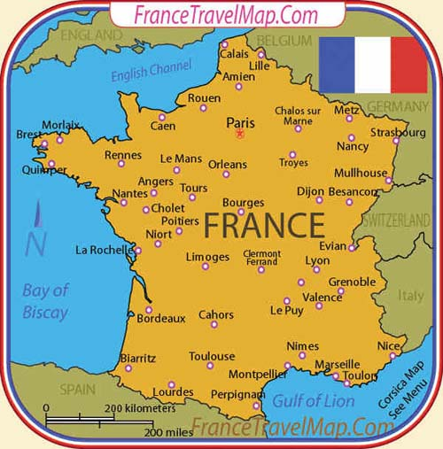
France

Slide 9
Colonies
Algeria, for example, was a former French colony who received its independence in 1962.
Almost 1 million French settlers up and moved back to France during this movement towards self-determination. Most were settlers but a large majority of them were of Algerian descent.

Slide 10
Take the good with the bad
Not all colonies had horror stories. (most did though). Some colonial powers still have close ties to their former colonies.
This “cooperation” takes the form of organizations. The French organisation is called the Francophonie. The British one (of which we are a part) is called the Commonwealth of Nations.

Slide 11
Question
How do you think WW2 affected Colonial independence?

Slide 12
Why decolonization was occurring
After the war, the imperial powers were too weak to fight to maintain these colonies.
Financial resources were depleted so any unnecessary costs were revisited
Powers knew that they really, really, really owed their colonies for helping them fight to maintain their independence so it does seem a bit hypocritical to send the message “Oh, Hey! Thanks for helping us get our freedom back but you can’t have yours”

Slide 13
Part 2
Remember that good ole Atlantic Charter that Churchill and Roosevelt signed in 1941 (on a boat) (somewhere in the Atlantic-suspected to be somewhere near NL)? Well that little thing stated that all colonies within the empire should have the right to self-determination.

Slide 14
Self-Determination
Freedom to live as one chooses, without exterior influences. The freedom to form one’s own government and also to decide own political and international status.

Slide 15
Indian Independence Act
An act passed by the British parliament in 1947 which split British India into two dominions: India and Pakistan. These two new countries would have their own governments and Governor-Generals in each country as set up by the Crown.

Slide 16
Apartheid
This directly translates as “apartness” A policy set up by the government in South Africa from 1948-1994 to racially segregate the non-white population living in SA. This policy stripped non-white South African people of their rights and freedoms through severely oppressive political and economic practices.

Slide 17
African National Congress
The ANC is the oldest black African political party in South Africa, founded in 1912.
This group, led by Nelson Mandela, was popular for its non-violent opposition to the Apartheid during the 60’s. Mandela was sentenced to life in prison for his leadership role and the group was exiled in 64’

Slide 18
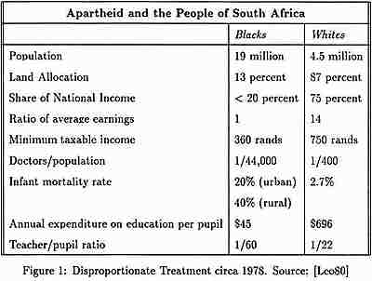

Slide 19
The penalties imposed on political protest, even non-violent protest, were severe. During the states of emergency which continued intermittently until 1989, anyone could be detained without a hearing by a low-level police official for up to six months. Thousands of individuals died in custody, frequently after gruesome acts of torture. Those who were tried were sentenced to death, banished, or imprisoned for life, like Nelson Mandela.

Slide 20
Suez Canal Crisis

Slide 21
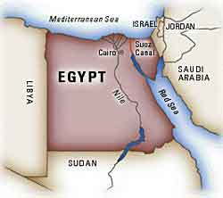

Slide 22
Background to the Suez Crisis:
Gamal Nasser emerged as the leader of Egypt in 1948.
His two main goals were to:
1. create an independent Egypt free from colonial rule
2. destroy the newly formed nation of Israel.
Nasser who held no preference for either communism or democracy was willing to accept American or Soviet aid.
To achieve his goals Nasser was willing let the superpowers bid for his allegiance. Nasser needed a modern army to destroy Israel and in 1955 he signed an arms deal with Czechoslovakia a Soviet bloc nation.

Slide 23
To develop Egypt economically and end colonial power he needed electricity. In 1956 he signed a deal with the U.S. to help build the Aswan Dam power project. Nasser’s balancing act of getting aid from both sides was about to crumble.
The Suez Crisis 1956: Nasser began to lose Western support due to America’s concern over Egypt’s continuing conflict with Israel which had close ties to the U.S.
Contrary to international and UN agreements Egypt stopped all Israeli ships and all ships bound for Israel from using the Suez Canal.
The U.S. then refused financial aid for the Aswan Dam. Nasser reacted immediately by seizing control of the Suez Canal and turned to the Soviets for help in building the Dam.
Egypt’s takeover of the Canal was peaceful;. Nevertheless this event increased global tensions. Britain and France devised a scheme to regain control of the Canal.
Israel was to attack Egypt as part of the ongoing Arab-Israeli dispute. Britain and France would land troops at the canal zone on the pretence to protect international shipping. Once here they would take control of the canal, Israel would expand its territory and Nasser would be overthrown. The conspirators miscalculated world reaction.

Slide 24
Results of the Suez Crisis: The Soviets threatened to launch missiles on Paris and London.
The United States was outraged with France and Britain. The U.S. introduced a motion at the UN calling for Israel to withdraw its troops and for all members to refrain from the use of force.
France and Britain vetoed this motion as well as a Soviet motion that the Soviets and Americans jointly intervene. The Security Council finally suggested that the matter go before the General Assembly.
) On Nov. 2 an American resolution called for a cease fire and international action to ensure the passage through the Suez Canal.
On Nov.4 Canada’s UN representative, Lester Person, proposed the British & French force in the Canal zone be replaced by a peacekeeping force. The lasting significance of the Suez Crisis was the creation of UN peacekeeping forces.

Slide 25
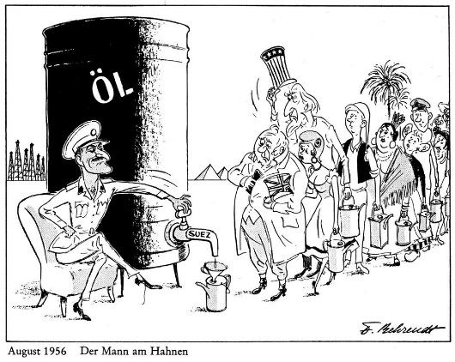

Slide 26
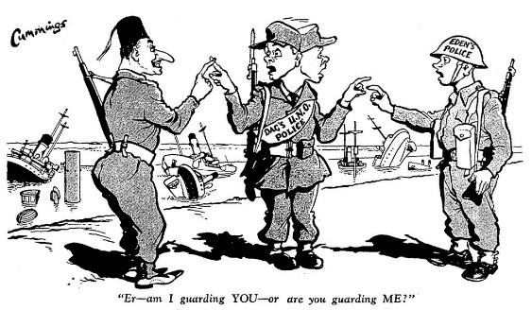

Slide 27
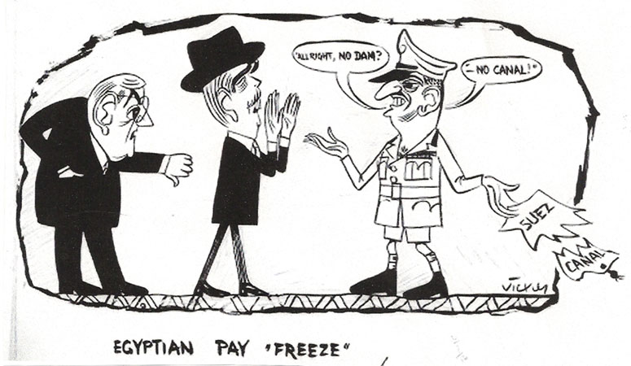

Slide 28
Independence Movement Leaders
Mahatma Gandhi
Gamal Abdel Nasser
Nelson Mandella
What were their methods to promote nationalism and independence and were the effective?

Slide 29
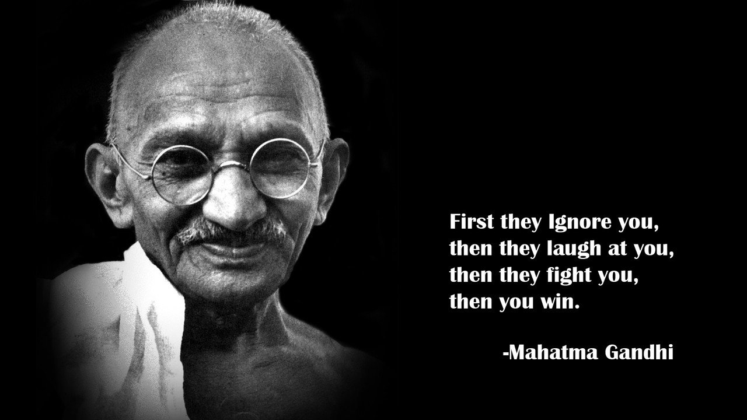
Gandhi

Slide 30
Methods:
Gandhi used non-violence and civil disobedience to help India achieve independence, he believed that Indian people had the right to freedom and self rule. Because Britain deprived India of its independence, Gandhi felt they should resist or break British law and encouraged Indian people to refuse to obey morally intolerable laws (Salt Tax). This is civil disobedience.
Some examples of civil disobedience were:
• resign from government jobs
• stop buying British goods
• refuse to pay taxes
• Purposely break unfair laws (1930 Salt March for example)
Effects:
Gandhi believed that the British would be defeated not when they had no strength but when they had no heart to fight against a moral, non-violent people. Gandhi’s methods were eventually successful and India became independent in 1947

Slide 31
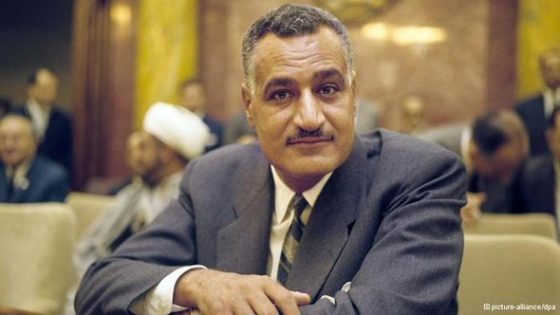
Nasser

Slide 32
Methods:
Nasser
Nasser and others formed a Free Officers movement aimed at driving out foreign powers.
In 1952 army officers forced the Egyptian King Farouk to abdicate. The monarchy was abolished and a new republic, with Nasser as president, was established in 1956.
Effects: Nasser was celebrated in Egypt for standing up to Europeans, redistributing wealth to improve the lives of citizens and pledging to restore Palestine to Palestinians.

Slide 33
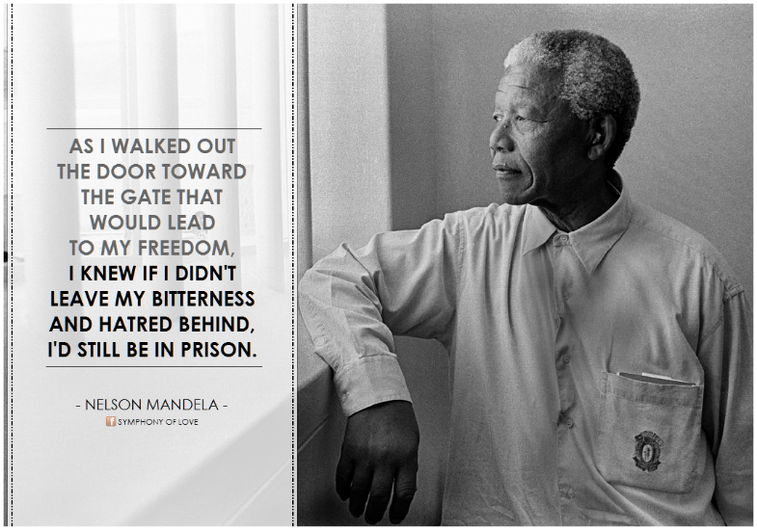
Mandella

Slide 34
Methods: In 1948 apartheid was introduced to South Africa. This racial policy separated South Africa into classes - a privileged white ruling class and an exploited subservient class.
Nationalist groups such as the African National Congress (ANC) began using boycotts, strikes, and demonstrations to attack racial discrimination in South Africa. The South African government responded by arresting ANC leaders such as Nelson Mandela.
Mandela joined the ANC in 1944 and in the 1950's he organized non-violent resistance against apartheid. Following the Sharpeville massacre in 1960 Mandela and others abandoned non-violent protest in favour of violent acts.
Effects: Mandela was sentenced to life imprisonment in 1963. While in prison from 1963 - 90 Mandela became an international figure with a worldwide following of supporters. He repeatedly refused offers of freedom in exchange for keeping quiet about apartheid.
This elevated him to mythical status among black South Africans. Eventually his fame grew that world leaders and the UN applied political pressure for Mandela’s release. Musicians, artists and writers championed Mandel’s cause.
Finally in 1990, the South African government facing civil unrest and world pressure, released Mandela. The government pledged reforms to create an equal and democratic South Africa. In 1994 Nelson Mandela was elected the first black president of South Africa.

Slide 35
Apartheid: South Africa
Birth of Apartheid
Racial segregation and white supremacy had become central aspects of South African policy long before apartheid began. The controversial 1913 Land Act, passed three years after South Africa gained its independence, marked the beginning of territorial segregation by forcing black Africans to live in reserves and making it illegal for them to work as sharecroppers.
Opponents of the Land Act formed the South African National Native Congress, which would become the African National Congress (ANC).
The Great Depression and World War II brought increasing economic woes to South Africa, and convinced the government to strengthen its policies of racial segregation. In 1948, the Afrikaner National Party won the general election under the slogan “apartheid” (literally “separateness”). Their goal was not only to separate South Africa’s white minority from its non-white majority, but also to separate non-whites from each other, and to divide black South Africans along tribal lines in order to decrease their political power.

Slide 36
Apartheid: South Africa
Apartheid Becomes Law
By 1950, the government had banned marriages between whites and people of other races, and prohibited sexual relations between black and white South Africans.
The Population Registration Act of 1950 provided the basic framework for apartheid by classifying all South Africans by race, including Bantu (black Africans), Coloured (mixed race) and white. A fourth category, Asian (meaning Indian and Pakistani) was later added. In some cases, the legislation split families; parents could be classified as white, while their children were classified as colored.
A series of Land Acts set aside more than 80 percent of the country’s land for the white minority, and “pass laws” required non-whites to carry documents authorizing their presence in restricted areas. In order to limit contact between the races, the government established separate public facilities for whites and non-whites, limited the activity of non-white labor unions and denied non-white participation in national government.

Slide 37
Apartheid: South Africa
Apartheid and Separate Development
Dr. Hendrik Verwoerd, prime minister in 1958, refined apartheid policy further into a system he referred to as “separate development.”
The Promotion of Bantu Self-Government Act of 1959 created 10 Bantu homelands known as Bantustans. Separating black South Africans from each other enabled the government to claim there was no black majority, and reduced the possibility that blacks would unify into one nationalist organization. Every black South African was designated as a citizen as one of the Bantustans, a system that supposedly gave them full political rights, but effectively removed them from the nation’s political body.
In one of the most devastating aspects of apartheid, the government forcibly removed black South Africans from rural areas designated as “white” to the homelands, and sold their land at low prices to white farmers. From 1961 to 1994, more than 3.5 million people were forcibly removed from their homes and deposited in the Bantustans, where they were plunged into poverty and hopelessness.

Slide 38
Apartheid: South Africa
Opposition to Apartheid
Resistance to apartheid within South Africa took many forms over the years, from non-violent demonstrations, protests and strikes to political action and eventually to armed resistance.
Together with the South Indian National Congress, the ANC organized a mass meeting in 1952, during which attendees burned their pass books.
A group calling itself the Congress of the People adopted a Freedom Charter in 1955 asserting that “South Africa belongs to all who live in it, black or white.” The government broke up the meeting and arrested 150 people, charging them with high treason.
In 1960, at the black township of Sharpesville, the police opened fire on a group of unarmed blacks associated with the Pan-African Congress (PAC), an offshoot of the ANC. The group had arrived at the police station without passes, inviting arrest as an act of resistance. At least 67 blacks were killed and more than 180 wounded. Sharpesville convinced many anti-apartheid leaders that they could not achieve their objectives by peaceful means, and both the PAC and ANC established military wings, neither of which ever posed a serious military threat to the state. By 1961, most resistance leaders had been captured and sentenced to long prison terms or executed.

Slide 39
Apartheid Comes to an End
In 1976, when thousands of black children in Soweto, a black township outside Johannesburg, demonstrated against the Afrikaans language requirement for black African students, the police opened fire with tear gas and bullets.
The protests and government crackdowns that followed, combined with a national economic recession, drew more international attention to South Africa and shattered all illusions that apartheid had brought peace or prosperity to the nation.
The United Nations General Assembly had denounced apartheid in 1973, and in 1976 the UN Security Council voted to impose a mandatory embargo on the sale of arms to South Africa. In 1985, the United Kingdom and United States imposed economic sanctions on the country.
Under pressure from the international community, the National Party government of Pieter Botha sought to institute some reforms, including abolition of the pass laws and the ban on interracial sex and marriage.
By 1989 Botha was pressured to step aside in favor of F.W. de Klerk. De Klerk’s government subsequently repealed the Population Registration Act, as well as most of the other legislation that formed the legal basis for apartheid.
A new constitution, which enfranchised blacks and other racial groups, took effect in 1994, and elections that year led to a coalition government with a non-white majority, marking the official end of the apartheid system.

Slide 40
Impact of Apartheid
Political: A country where white people have all the political power and black people are disenfranchised from power (divided even among tribal lines themselves so it would appear there was no black majority). All political power held by whites.
Social: Long lasting social division between black and white and those classified as “other,” these arbitrary divisions even split families. There is a lasting legacy of racism and oppression which is still evident today.
Economic: White people were legally given the majority of the good farming land and the most desirable places to live, the best jobs, education and facilities. The uprisings, protests, violence and legacy of systemic racism is arguably still impacting the economic situation in South Africa today.

