Slide 1
The Great Depression
History 2203

Slide 2
Overview
The Great Depression (1929-39) was the deepest and longest-lasting economic downturn in the history of the Western industrialized world. In the United States, the Great Depression began soon after the stock market crash of October 1929, which sent Wall Street into a panic and wiped out millions of investors.
Over the next several years, consumer spending and investment dropped, causing steep declines in industrial output and rising levels of unemployment as failing companies laid off workers. By 1933, when the Great Depression reached its height, some 13 to 15 million Americans were unemployed and nearly half of the country’s banks had failed.
The relief and reform measures put into place by President Franklin D. Roosevelt helped lessen the worst effects of the Great Depression in the 1930s, the economy would not fully turn around until after 1939, when World War II kicked industry into high gear.

Slide 3
The Stock Market Crash 1929
The American economy entered an ordinary recession during the summer of 1929, as consumer spending dropped and unsold goods began to pile up, slowing production.
Stock prices continued to rise, and by the fall of that year had reached levels that could not be justified by anticipated future earnings. On October 24, 1929, the stock market bubble finally burst, as investors began dumping shares en masse. A record 12.9 million shares were traded that day, known as “Black Thursday.”
Five days later, on “Black Tuesday” some 16 million shares were traded after another wave of panic swept Wall Street. Millions of shares ended up worthless, and those investors who had bought stocks “on margin” (with borrowed money) were wiped out completely.

Slide 4
The Fall Out
As consumer confidence vanished in the wake of the stock market crash, the downturn in spending and investment led factories and other businesses to slow down production and construction and begin firing their workers.
For those who were lucky enough to remain employed, wages fell and buying power decreased. Many Americans forced to buy on credit fell into debt, and the number of foreclosures and repossessions climbed steadily.

Slide 5
Causes of the Great Depression
1. Over-Production and over-expansion by businesses
2. Consumer over spending on credit during the ‘Roaring Twenties”
3. Impact of High tariffs on international trade
4. Too many stock purchases on credit/Stock Market Crash 1929

Slide 6
1. Over-Expansion by Business in the 20’s
At the end of WWI, people wanted a return to normalcy. Many people were looking forward to years of prosperity and felt that the Great War was the “war to end all wars,” and people could now focus on the stereotypical ideal of Western life.
The government invested heavily in business and in banking. Women returned to the homes (after working in factories during WWI) and men returned to work
Businesses recognized that people were looking for years of wealth, prosperity and happiness and began to produce the many products that consumers to buy to “improve their lives!”
Credit was introduced, and people could purchase many goods now and pay later. The increased profits from these sales meant business could expand rapidly, hire more people and increase the price of stock to invest in their companies. Companies appeared more profitable and valuable than they actually were. Debt fueled the growth of business, and this could not go on forever.

Slide 7
2. The Roaring Twenties
False Sense Of Prosperity Before The Great Depression
The 1920s, known as “The Roaring Twenties” marked a time when America was over dependent on production, automobiles were the leading industry, and there was a great disparity between rich and poor.
More than 60% of the population was living below poverty levels, while a mere 5% of the wealthiest people in America accounted for 33% of the income, and the richest 1% owned 40% of the nation’s wealth.
This uneven distribution of wealth was mirrored in the unequal distribution of riches between industry and agriculture

Slide 8
3. Impact of High tariffs on international trade
As businesses began failing, the government created the Smoot-Hawley Tariff in 1930 to help protect American companies. This charged a high tax for imports from foreign countries. The unintended consequence of this tariff was that less trade occurred between America and foreign countries. In addition, some countries retaliated economically against the US.

Slide 9
4. Stock Market Crash
Many believe erroneously that the stock market crash that occurred on Black Tuesday, October 29, 1929 is one and the same with the Great Depression. In fact, it was one of the major causes that led to the Great Depression. Two months after the original crash in October, stockholders had lost more than $40 billion dollars. Even though the stock market began to regain some of its losses, by the end of 1930, it just was not enough and America truly entered what is called the Great Depression.

Slide 10
Other Contributing Factors
People Stopped Spending Money During The Great Depression
When the stock market crashed, and the banks failed, and unemployment levels reached higher and higher points, people understandably stopped spending money, which also deepened the economic crisis as demand for products and services ground to a halt.
High Unemployment Rates During The Great Depression
When consumer spending plummeted during the Great Depression, unemployment rose, reaching its highest level in 1933, when 25% of the workforce was idle.
Dust Bowl During The Great Depression
A drought that lasted from 1930 to 1936, known as the Dust Bowl, aggravated the problems of the Great Depression. More than a million acres of farmland were rendered useless because of severe drought and years of overfarming, and hundreds of thousands of farmers joined the ranks of the unemployed

Slide 11
Too Much and Not Enough!
Poverty of Abundance
What made the miseries of the Great Depression so incomprehensible to those who endured them was the evident fact that the economic collapse had been caused not by want but by material abundance. The problem with American capitalism in the 1930s was that there was too much of everything—too much supply, not enough demand. Too many automobiles, and not enough workers who could afford to buy them. Too much cotton, too much corn, too much pork, too much beef, too much wheat, and not enough buyers able to pay a price that made the crops worth harvesting. Too many workers needing jobs, and not enough employers to hire them.

Slide 12
The Global Depression
Global Crisis And The Great Depression
While America prospered during the 1920s, most of Europe, still reeling from the devastation of World War I, fell into economic decline. America soon became the world’s banker, and as Europe started defaulting on loans and buying less American products, the Great Depression spread

Slide 13
Canada in the Great Depression
How The Provinces Were Effected
It was estimated back in the thirties that 33% of Canada's Gross National Income came from exports; so the country was also greatly affected by the collapse of world trade. The four western prairie provinces were almost completely dependent on the export of wheat. The little money that they brought in for their wheat did not cover production costs, let alone farm taxes, depreciation and interest on the debts that farmers were building up. The net farm income fell from $417 million in 1929 to $109 million in 1933.
Between 1933 and 1937 to make matters even worse, Saskatchewan suffered a drought. The money brought in for the wheat was at a record low and the provincial income dropped by 90% in two years, forcing 66% of the province into relief. Where the previous yield per acre was 27 bushels, it had dropped to as little as three in 1937. The price of grain also dropped from $1.60 a bushel to $0.28 a bushel in 1932. Although Ontario and Quebec were experiencing serious unemployment, as mining and forest incomes from exports had dropped though they were less effected due to more diversified industrial economics, which, luckily for them, protected they domestic market.

Slide 14
Canada in the Great Depression
For BC, the fish, lumber and fruit markets were considerably lower but they weren't as hard hit as the majority of the provinces. As for the Maritimes, they had entered provincial economic decline in the 1920's so therefore they had less of a margin to fall by. There was also a larger variety of jobs so the whole income wasn't wiped out due to the fall of one market. In 1934 Newfoundland had to surrender its government responsibilities and had to ask for financial aid from Britain.

Slide 15
America and the Great Depression
The Great Depression transformed American social and political institutions and the ways individual people thought about themselves and their relationship to the country and the world. Though no two people had the same understanding of the Depression, everyone felt challenged and changed by the experience.
By 1932, three years after the initial crash, near thirty million Americans had lost their source of income, from unemployment or loss of a family breadwinner. This included more than a quarter of the population of Washington State. Of those lucky enough to have consistent work, more than half were reduced to part-time schedules. Though there had been devastating economic depressions before, the 1930s crisis encompassed both urban and rural regions and devastated middle-class and working-class people alike

Slide 16
America and the Great Depression
After 1933, the expansion of the New Deal meant that the government now intervened much more clearly in people’s daily lives, employing them and giving them aid, as well as providing new forms of social insurance. A wave of labor strikes and unionization allowed for a new way of thinking about the power of ordinary people and racial and gender divisions. Some responded to the crisis by looking for different forms of social, political, and economic organization, and turned to radical— and sometimes, conservative —movements. Burgeoning arts movements and media innovations, like radio, allowed for multifaceted forms of expression.

Slide 17
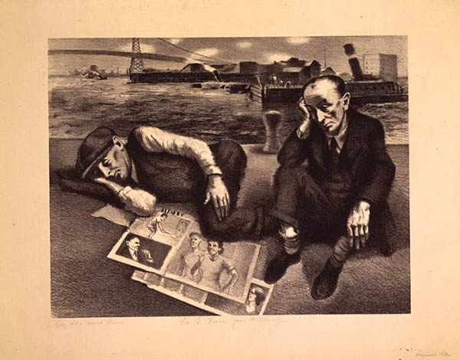
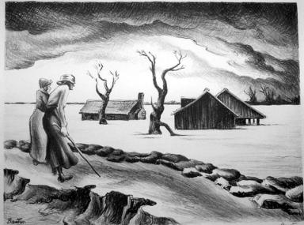
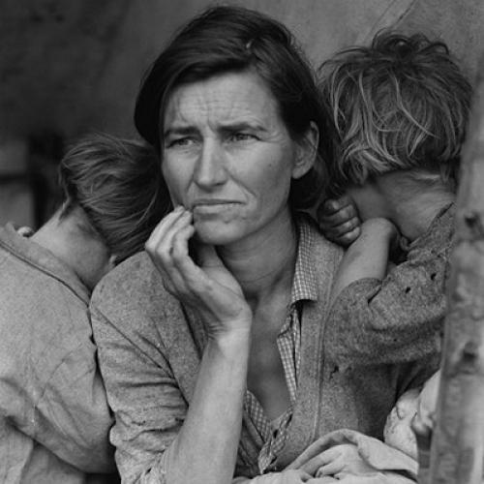
Artistic Expression

