Slide 1
The Crucible
A Play by Arthur Miller

Slide 2
Arthur Miller
Arthur Asher Miller (October 17, 1915 – February 10, 2005) was an American playwright, essayist, and figure in twentieth-century American theatre. Among his most popular plays are All My Sons (1947), Death of a Salesman (1949), The Crucible (1953) and A View from the Bridge (1955, revised 1956). He also wrote several screenplays and was most noted for his work on The Misfits (1961). The drama Death of a Salesman has been numbered on the short list of finest American plays in the 20th century alongside Long Day's Journey into Night and A Streetcar Named Desire.
Miller was often in the public eye, particularly during the late 1940s, 1950s and early 1960s. During this time, he was awarded the Pulitzer Prize for Drama; testified before the House Un-American Activities Committee; and was married to Marilyn Monroe.

Slide 4
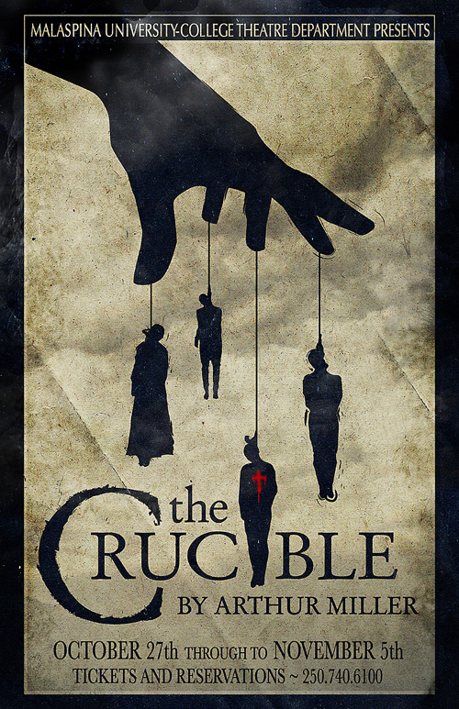
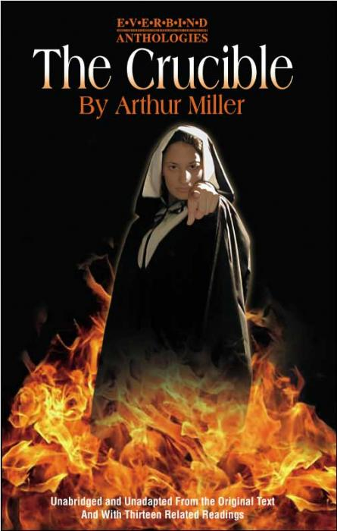

Slide 5
The Crucible is a 1953 play by American playwright Arthur Miller. It is a dramatized and partially fictionalized story of the Salem witch trials that took place in the Massachusetts Bay Colony during 1692-93. Miller wrote the play as an allegory of McCarthyism, when the U.S. government blacklisted accused communists. Miller himself was questioned by the House of Representatives' Committee on Un-American Activities in 1956 and convicted of contempt of Congress for refusing to identify others present at meetings he had attended.
The play was first performed at the Martin Beck Theatre on Broadway on January 22, 1953, starring E.G. Marshall, Beatrice Straight and Madeleine Sherwood. Miller felt that this production was too stylized and cold and the reviews for it were largely hostile (although The New York Times noted "a powerful play [in a] driving performance").Nonetheless, the production won the 1953 Tony Award for Best Play. A year later a new production succeeded and the play became a classic. It is a central work in the canon of American drama.

Slide 6
McCarthyism
McCarthyism is "the practice of making unfair allegations or using unfair investigative techniques, especially in order to restrict dissent or political criticism.“
The term has its origins in the period in the United States known as the Second Red Scare, lasting roughly from 1950 to 1956 and characterized by heightened political repression against supposed communists.
During the McCarthy era in the US, thousands of Americans were accused of being communists or communist sympathizers and became the subject of aggressive investigations and questioning before government or private-industry panels, committees and agencies.
The primary targets of such suspicions were government employees, those in the entertainment industry, educators and union activists.

Slide 7
Themes
Intolerance
The Crucible is set in a theocratic society, in which the church and the state are one, and the religion is a strict, austere form of Protestantism known as Puritanism. Because of the theocratic nature of the society, moral laws and state laws are one and the same: sin and the status of an individual’s soul are matters of public concern. There is no room for deviation from social norms.
The witch trials are the ultimate expression of intolerance (and hanging witches is the ultimate means of restoring the community’s purity); the trials brand all social deviants with the taint of devil-worship and thus necessitate their elimination from the community

Slide 8
Hysteria
Another critical theme in The Crucible is the role that hysteria can play in tearing apart a community.
Hysteria supplants logic and enables people to believe that their neighbors, whom they have always considered upstanding people, are committing absurd and unbelievable crimes—communing with the devil, killing babies, and so on.
In The Crucible, the townsfolk accept and become active in the hysterical climate not only out of genuine religious piety but also because it gives them a chance to express repressed sentiments and to act on long-held grudges. The most obvious case is Abigail, who uses the situation to accuse Elizabeth Proctor of witchcraft and have her sent to jail.

Slide 9
Reputation
Reputation is tremendously important in Salem, where public and private moralities are one and the same.
In an environment where reputation plays such an important role, the fear of guilt by association becomes particularly pernicious. Focused on maintaining public reputation, the townsfolk of Salem must fear that the sins of their friends and associates will taint their names.
Various characters base their actions on the desire to protect their respective reputations. integrity.

Slide 10
Motifs
Empowerment
The witch trials empower several characters in the play who are previously marginalized in Salem society. In general, women occupy the lowest rung of male-dominated Salem and have few options in life. They work as servants for townsmen until they are old enough to be married off and have children of their own. In addition to being thus restricted, Abigail is also slave to John Proctor’s sexual whims—he strips away her innocence when he commits adultery with her, and he arouses her spiteful jealousy when he terminates their affair. Because the Puritans’ greatest fear is the defiance of God, Abigail’s accusations of witchcraft and devil-worship immediately command the attention of the court. By aligning herself, in the eyes of others, with God’s will, she gains power over society, as do the other girls in her pack, and her word becomes virtually unassailable, as do theirs. Tituba, whose status is lower than that of anyone else in the play by virtue of the fact that she is black, manages similarly to deflect blame from herself by accusing others

Slide 11
Accusations, Confessions, and Legal Proceedings
The witch trials are central to the action of The Crucible, and dramatic accusations and confessions fill the play even beyond the confines of the courtroom. In the first act, even before the hysteria begins, we see Parris accuse Abigail of dishonoring him, and he then makes a series of accusations against his parishioners. Giles Corey and Proctor respond in kind, and Putnam soon joins in, creating a chorus of indictments even before Hale arrives. The entire witch trial system thrives on accusations, the only way that witches can be identified, and confessions, which provide the proof of the justice of the court proceedings. Proctor attempts to break this cycle with a confession of his own, when he admits to the affair with Abigail, but this confession is trumped by the accusation of witchcraft against him, which in turn demands a confession. Proctor’s courageous decision, at the close of the play, to die rather than confess to a sin that he did not commit, finally breaks the cycle. The court collapses shortly afterward, undone by the refusal of its victims to propagate lies.

Slide 12
Symbolism
The Witch Trials and McCarthyism : There is little symbolism within The Crucible, but, in its entirety, the play can be seen as symbolic of the paranoia about communism that pervaded America in the 1950’s.

Slide 14
The Salem Witch Trials
The Salem witch trials were a series of hearings and prosecutions of people accused of witchcraft in colonial Massachusetts between February 1692 and May 1693.
The trials resulted in the executions of twenty people, fourteen of them women, and all but one by hanging. Five others (including two infant children) died in prison.
Twelve other women had previously been executed in Massachusetts and Connecticut during the 17th century. Despite being generally known as the Salem Witch Trials, the preliminary hearings in 1692 were conducted in several towns: Salem Village (now Danvers), Salem Town, Ipswich, and Andover. The most infamous trials were conducted by the Court of Oyer and Terminer in 1692 in Salem Town.

Slide 15
The Salem Witch Trials 1962 Documentary
CHECK OUT THIS DOCUMENTARY FROM THE HISTORY CHANNEL!!!
https://www.youtube.com/watch?v=5E_SgJOmR3Y

Slide 16
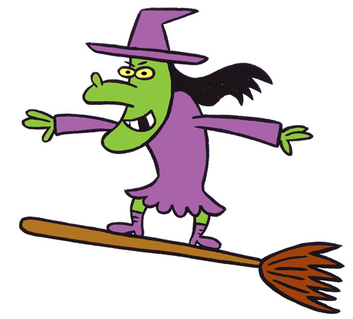
What is up with the human fascination with witches?
Where do witches appear in pop culture? TV? Movies? Literature? Make a list.
Why are we so fascinated with witches?
Do you believe in witchcraft or wizardry?

Slide 17
