Slide 1
The Cold War
History 3201

Slide 3
The Cold War in A Nutshell
The Cold War is the name given to the relationship that developed primarily between the USA and the USSR after WWII. It dominated international affairs for decades and many major crises occurred: The Cuban Missile Crisis, Vietnam, Hungary and the Berlin Wall.
The growth in weapons of mass destruction was the most worrying issue, as countries reached a “flashpoint” and nuclear war seemed imminent before issues were resolved.
A clash of very different beliefs and ideology – capitalism versus communism – each held with almost religious conviction, formed the basis of an international power struggle with both sides vying for dominance, exploiting every opportunity for expansion anywhere in the world.

Slide 4
4.1.1: Define Cold war and containment
Cold War: The period following WWII, 1945 to 1990, when increasing diplomatic and political tension between the West / United States and the East / Soviet Union created the constant threat of war.
Containment: The defensive American foreign policy developed in 1947 to contain the spread of communism through economic and technical assistance to threatened countries. The policy later included military force.

Slide 5
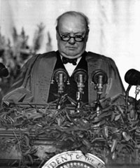
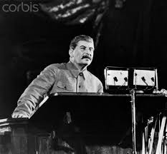
4.1.2 Speeches
Stalin’s “Two Hostile Camps” speech and Churchill’s “Iron Curtain” speech in 1946 alerted the world to the deteriorating relationship between the Soviet Union and Western World.

Slide 6
Stalin’s Two Hostile Camps Speech
Stalin’s "Two Hostile Camps Speech": In Feb. 1946 Stalin gave a speech to voters in Moscow. In it he predicted that the unevenness of development in capitalist countries would result in a split of two hostile camps with war the inevitable result. He also warned that the future would not bring internal or external peace. In Washington Stalin’s words were interpreted to mean that war with the West was inevitable.

Slide 7
Churchill’s “iron Curtain” Speech
Churchill’s "Iron Curtain Speech": Churchill had always distrusted Stalin and in March 1946 accepted an invitation from President Truman to visit the U.S. In his speech Churchill warned Americans of the Soviet threat and the need for an "association of English speaking peoples" acting outside of the U.N. to re-order the world. His speech convinced many Americans that Truman’s "get tough" approach to the soviets was the right one.

Slide 8
The Iron Curtain
The Iron Curtain was the imaginary boundary dividing Europe into two separate areas from the end of World War II in 1945 until the end of the Cold War in 1991. The term symbolized efforts by the Soviet Union to block itself and its satellite states from open contact with the west and non-Soviet-controlled areas.

Slide 9
The Iron Curtain

Slide 10
The Iron Curtain

Slide 11
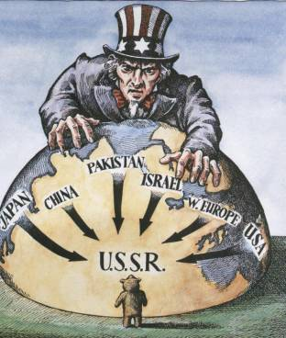
4.1.3: Containment
Containment is a military strategy to stop the expansion of an enemy. It is best known as the Cold War policy of the United States and its allies to prevent the spread of communism abroad. The policy of containment was put into action in the Truman Doctrine, Marshall Plan, Berlin Airlift and formation of NATO.

Slide 12
Truman Doctrine
March 1947 President Truman called on the U.S to resist communism throughout the world.
He stated, ... it must be the policy of the U.S to support free peoples who are resisting attempted subjugation... our help should be primarily through economic and financial aid... free peoples of the world look to us for support in maintaining their freedoms.
Truman’s speech was designed to get support for an American pledge of hundreds of millions of dollars to prevent the spread of communism in Europe.
The policy of fighting communism around the world became known as the Truman Doctrine. American aid would be given to a number of regimes, including right wing dictatorships, in an effort to block communism.

Slide 13
Marshall Plan
In 1947 Western Europe was in the midst of a postwar depression. Unemployment and social unrest were a concern. If countries were to remain free of Soviet influence they would have to regain their economic and political strength.
June 1947 the Marshall Plan was announced. It offered aid to all countries (even those in the Soviet bloc) devastated by the war.
16 European countries accepted over 13 billion in aid. As a result industrial growth flourished in Western Europe which resulted in economic and political stability. One other benefit/goal was that the U.S. economy enjoyed unprecedented growth in the 1950's. Wealthy European countries would not turn to communism.

Slide 14
Formation of Nato
In April 1949 was established, led by the United States it brought 12 countries together to counter the perceived threat from the Soviet Bloc countries.
An attack on one country would be an attack against all. NATO indicated the West’s intent to meet Soviet expansion with collective resistance.

Slide 15
4.1.4 Soviet Reaction to containment

Slide 16
Molotov PLan
The Molotov Plan was the system created by the Soviet Union in 1947 in order to provide aid to rebuild the countries in Eastern Europe that were politically and economically aligned to the Soviet Union.
It can be seen to be the USSR's version of the Marshall Plan, which for political reasons the Eastern European countries would not be able to join without leaving the Soviet sphere of influence.
The Molotov plan was symbolic of the Soviet Union's refusal to accept aid from the Marshall Plan, or allow any of their satellite states to do so, because of their belief that the Plan was an attempt to weaken Soviet interest in their satellite states, through the conditions imposed, and by making beneficiary countries economically dependent on the United States.

Slide 17
Berlin Blockade/airlift
After World War II, the Allies partitioned the defeated Germany into a Soviet-occupied zone, an American-occupied zone, a British-occupied zone and a French-occupied zone.
Berlin, the German capital city, was located deep in the Soviet zone, but it was also divided into four sections. In June 1948, the Russians–who wanted Berlin all for themselves–closed all highways, railroads and canals from western-occupied Germany into western-occupied Berlin. They believed, would make it impossible for the people who lived there to get food or any other supplies and would eventually drive Britain, France and the U.S. out of the city for good.
Instead of retreating from West Berlin, however, the U.S. and its allies decided to supply their sectors of the city from the air. This effort, known as the “Berlin Airlift,” lasted for more than a year and carried more than 2.3 million tons of cargo into West Berlin.

Slide 19
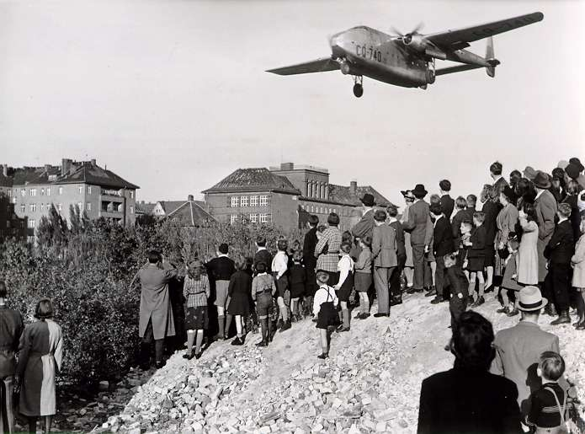

Slide 20
Warsaw pact
The Soviet Union and seven of its European satellites sign a treaty establishing the Warsaw Pact, a mutual defense organization that put the Soviets in command of the armed forces of the member states.
The treaty was signed in Warsaw, included the Soviet Union, Albania, Poland, Romania, Hungary, East Germany, Czechoslovakia, and Bulgaria as members. The treaty called on the member states to come to the defense of any member attacked by an outside force and it set up a unified military command under Marshal Ivan S. Konev of the Soviet Union.
The introduction to the treaty establishing the Warsaw Pact indicated the reason for its existence. This revolved around “Western Germany, which is being remilitarized, and her inclusion in the North Atlantic bloc, which increases the danger of a new war and creates a threat to the national security of peace-loving states.” This passage referred to the decision by the United States and the other members of the North Atlantic Treaty Organization (NATO) on May 9, 1955 to make West Germany a member of NATO and allow that nation to remilitarize. The Soviets obviously saw this as a direct threat and responded with the Warsaw Pact.
The Warsaw Pact remained intact until 1991

Slide 21
Nato and warsaw pact map 1955

Slide 22
4.2.1 Definitions
Uniting for Peace resolution: U.N. resolution that gave the General assembly power to deal with issues of international aggression if the Security Council is deadlocked.
Veto: The right to reject a proposal or forbid an action.
Viet Cong: were rebels who tried to overthrow the government of South Vietnam in the sixties. The wanted to reunite South Vietnam under the communist government of North Vietnam.
Viet Minh: For a long time Vietnam was a French Colony. After WWII People in Vietnam wanted their independence. The Viet Minh was a group of rebels that fought the French until 1954 when France agreed to leave and allow Vietnam to become independent. When they went to set up their new country. American support for capitalism in the South forced them to split the country in two - socialist North Vietnam and U.S. Friendly South Vietnam. We don't use the term Viet Minh after the 1950s. Its leadership became the leadership of the new country of North Vietnam. It might have been the leaders of all of Vietnam if the Americans had stayed out of it, or if South Vietnam let people vote.

Slide 23
Korean war
Cause:
Following WWII the Soviets held North Korea while the U.S. held the South.
Korea was to be reunited following a peace settlement but, as with Germany, the Cold war intervened and Korea remained divided.
Unable to get Soviet cooperation the United States turned the issue over to the UN where the General Assembly established a commission to oversee free elections and set up a unified independent government.
The Soviets held their own election and established North Korea (Communist). The Americans did the same and formed South Korea (Democratic)
War broke out in June 1950 when Northern forces crossed the 38th parallel and invaded the South.

Slide 24
Korean War Results
Results:
The day after the invasion Truman pledged American military support against any act of communist expansion in Asia. At the UN the U.S introduced the Uniting for Peace Resolution demanding that the North withdraw (there was no Soviet veto because they were boycotting the UN over America’s refusal to allow the new Chinese communist government to take China’s seat in the UN).
With the Soviets out the U.N. Security Council approved military action against the North.
Early in the war the North enjoyed success then the American led UN forces successfully counter attacked. The American military leader wanted to pursue the North Koreans across the 38th parallel even into China but Truman not wanting WW III ordered him to halt as the UN resolution only gave them authority to restore South Korea.
In July 1953 a truce was reached the country remained divided at the 38th parallel.

Slide 25
Cuban Missile Crisis
Causes:
Cuba, 150 Km off the coast of Florida, had long been in the American sphere of influence. Most of the wealth in Cuba belonged to American businesses and The U.S. supported Cuba’s corrupt dictator, Batista.
In 1959 a young socialist named Fidel Castro led a popular uprising that overthrew Batista. He set up a new government patterned after the socialist ideals envisioned by Karl Marx. Castro wanted to regain control of Cuba’s economy, for the benefit of all Cubans. In the process he nationalized all privately owned businesses, which means he appropriated them, or claimed them as the property of the people of Cuba.
American investors lost approximately 1 billion dollars, were outraged. America would neither buy anything from Cuba, nor sell anything to Cuba. Castro carried on and succeeded in creating a first class health care and public education system.
Castro found a friend in the Soviets who bought huge quantities of Cuban sugar and shipped military weapons to Cuba. Threats from the U.S. pushed Cuba closer to the Soviets.
In April 1961 a small army of Cuban exiles, trained by the American CIA invaded Cuba at the Bay of Pigs. The invasion failed and the invaders were quickly defeated. More importantly the invasion strengthened Cuba’s ties to the Soviets.
In October 1962 American spy planes revealed that the Soviets were building missile bases in Cuba that could be used to launch nuclear weapons at the U.S. A nuclear war seemed likely

Slide 26
Cuban Missile Crisis
Results:
President Kennedy ordered a naval blockade of Cuba in order to keep supplies needed to complete the missile bases from reaching Cuba. A naval blockade is internationally recognized as an act of war. Kennedy hoped that calling it a 'Quarantine' might soften its impact.
In an effort to avoid war, the Soviets sent secret proposals with a potential solution. Kennedy sent his brother to meet with the Soviet Ambassador and accept the soviet solution. The Soviets would withdraw missiles from Cuba and the U.S. would promise never to invade Cuba, and that they would remove missiles aimed at the USSR, in Turkey
The crisis was over and both sides realized there could be no victory in a nuclear war. The crisis also demonstrated the need for better communication between the two countries as a result the famous hotline was established.

Slide 27
Vietnam War
Causes:
For a long time Vietnam was a French Colony, but after WWII People in Vietnam didn't want to be colonists anymore. They wanted their own country.
The Viet Minh was a group of rebels led by Ho Chi Minh that rose up to fight the French, France conceded.
When the Vietnamese went to set up their new country however, American support for capitalism in the South forced them to split the country in two - communist North Vietnam and U.S. Friendly South Vietnam
The split was supposed to be temporary and, at a peace conference in Switzerland, it was agreed that Vietnam would be divided at the 17th parallel until elections would be held in 1956 to reunite the country.
South Vietnam dictator Diem, never allowed free elections. Dictator Diem in the south was repressive and cruel.

Slide 28
Vietnam War
Results:
The U.S. followed the policy of containment. The U.S. believed in something called the domino theory. According to this theory the fall of one nation to communism would lead to nearby countries becoming communist.
In1960 the U.S. sent military advisors to help the south Vietnamese army. The new President Lyndon Johnson did not want to be accused of being soft on communism. He got the American Congress to give him the power to use force. By 1965 the U.S. 500,000 troops fighting in Vietnam.
By 1975 the U.S. gave up. North Vietnam occupied South Vietnam and reunited the country. More than a million Vietnamese had been killed. The economies of the North and South were drained. Communism was not contained. The war proved that containment through military force was unworkable and that American military power was not invincible.
Americans were divided over the war: anti-war protests, demonstrations often became violent, public burning of draft cards and American flag, tens of thousands of Americans fled to Canada as draft dodgers. 57,000 Americans were killed another 300,000 were wounded and 2500 were listed as Missing in Action. Tragically another 50,000 have committed suicide and larger numbers battle substance abuse. Financially the U.S. spent 150 billion on the war effort.

Slide 29
4.2.3 The Korean War: Containment or UN Peacemaking?
The Korean War provides a better example of United Nations peace making because:
This was an initiative sanctioned by a Resolution that was voted on and approved by the United Nations.
The action was supported by the involvement of the armed forces of 16 nations, not just the United States.
An additional 30 countries supplied medical units, hospital ships, food, supplies, and equipment.
This is a situation where one nation was invading another and therefore the United Nations had an obligation to intervene ie. North Korea invaded South Korea.

Slide 30
Containment
The Korean War provides a better example of American containment because:
This is not an example of one nation invading another nation. The two nations were set up artificially a few years earlier because the United States and the Soviet Union could not agree on what sort of government the country of Korea would have. Korea should have been left alone to sort out its own affairs.
The vast majority of the United Nations' forces were American forces led by an American general.
The supporting nations were all supporters of the United States.
The initiative would never have been promoted or pushed by the United States if North Korea had not been communist.
The resolution would never have been passed in the United Nations Security Council if the Soviet Union or China had been present for the vote.
Even if one could accept the argument that this was a situation where an invading country must be driven out of the country it invaded, why then did the United Nations forces not stop at the 38th parallel when they had driven North Korean forces out of South Korea? Why did they push to defeat the North Korean forces entirely? They pushed them right up to the Yalu River, intending to unite the entire peninsula under the authority of the South Korean government.

Slide 31
4.2.4 the cold war: thinking and culture
Space Age Fashion
Futurism begins to influence fashion in a big way. This space hat is from 1965, by Edward Mann.

Slide 32
Architectural Vision: The New York City skyline is sliced through in a conceptual artwork by the neo-avant-garde Italian architectural group, Superstudio. They suggested universal architecture could link places together in a metaphysical sense.

Slide 33
Radical Chic
Political consciousness in art raises the theme of Third World revolution as 'freedom fighters' peer into a chic American interior. The artwork seen here is by Paris-based Icelandic artist Erro (Gudmundur Gudnumddson).

Slide 34
Radio Tech
Fantasy became fact in 1957 when the first satellite 'bleep' from Sputnik hit the radio waves. East and West vied for eminence in telecommunications with ever more grandiose teletowers. The Jested tower in Liberec, Czechoslovakia (1968-73) was possibly the most extraordinary. It continued the profile of the mountain it perched atop and its skin was made from fibreglass rods and panels to allow unhindered radio and TV transmissions.

Slide 35
Peace Partisan
Pablo Picasso bridged the worlds of art and politics when he designed a scarf to commemorate the 'World Festival of Youth and Students for Peace', in Berlin, August 1951.

Slide 36
4.3.1 Definitions
Détente: The relaxation of international tensions, specifically between the Soviets and Americans in the 1970's.
Star Wars: Strategic Defence Initiative, U.S. plan to destroy Soviet satellites and missiles while in flight.

Slide 37
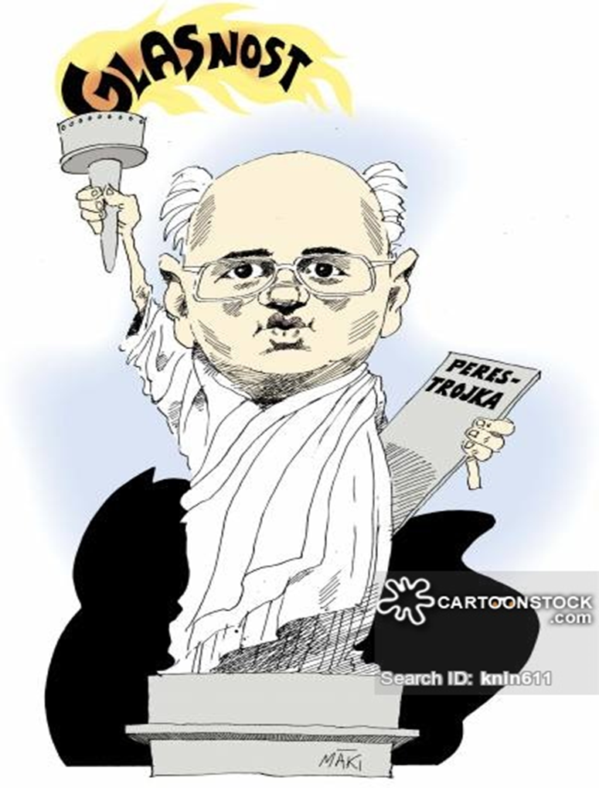
Mikhail Gorbachev

Slide 38
Mikhail Gorbachev
In 1985 Mikhail Gorbachev became the new Soviet leader.
Younger, better educated and open minded
Realized that the threat to the USSR was economic collapse not invasion from the West.
Years of maintaining a military presence in other parts of the world had drained the economy.
The situation was made worse by the communist system of guaranteed employment and lack of incentives which did little to develop innovation, competence or hard work.
To deal with this problem Gorbachev introduced reforms.

Slide 39
Impact of Perestroika and Glasnost in the Soviet Union 3.3.2
Perestroika : the restructuring of the Soviet Union’s economy to make it more productive by moving away from communism towards a free market.
resulted in dissatisfaction and frustration. Without government subsidies food and consumer goods became more expensive which was unpopular with people.
By 1990 little headway had been made as hard line communists resisted change.
Inflation and strikes led to poor working and living conditions and political instability in the Soviet Union by 1991.
As the economy worsened so did social conditions: crime swept the country, health care unraveled, infant mortality rates rose and life expectancy declined, pollution levels created health hazards, alcoholism became the third most common cause of death.

Slide 40
Glasnost: a policy of openness and increased freedom that removed censorship. It was hoped that by opening communication it would lead to a better society.
Glasnost resulted in Gorbachev’s fall from power. With the freedom glasnost provided people who felt Gorbachev was not moving fast enough to bring changes to the USSR began to criticize him.
At the same time old communists opposed Gorbachev, feeling he had already gone too far with reforms.
These two different views would bring events to a climax in the Soviet Union that would result in Gorbachev’s fall from power and the collapse of the Soviet Union in 1991. Thus ending the Cold War

Slide 43
4.3.3 Gorbachev’s reform impacts the soviet union; eastern Europe; and the global community
When Gorbachev became leader of the Soviet Union he introduced a number of reforms which had a significant impact.
Gorbachev’s reforms of perestroika and glasnost brought about the end of Communism in Russia in 1991.
He also introduced a series of peace reforms in 1985 that would significantly impact Eastern Europe.

Slide 44
Soviet Union
While Gorbachev's political initiatives were positive for freedom and democracy in the Soviet Union and its Eastern bloc allies, the economic policy of his government gradually brought the country close to disaster.
By the end of the 1980s, severe shortages of basic food supplies (meat, sugar) led to the reintroduction of the war-time system of distribution using food cards that limited each citizen to a certain amount of product per month. Compared to 1985, the state deficit grew from 0 to 109 billion rubles; gold funds decreased from 2,000 to 200 tons; and external debt grew from 0 to 120 billion dollars.
Gorbachev’s reforms led to the end of the Soviet Union and the collapse of communism.

Slide 45
Soviet Union
Coups and political unrest destroyed Gorbachev politically.
The Soviet Union collapsed with dramatic speed during the latter part of 1991, as one republic after another declared independence from the Soviet Union, Gorbachev’s hope of union with countries in the Soviet Bloc were destroyed.
Gorbachev could no longer influence events outside Moscow, and he was challenged even there.
With the country in a state of near collapse, Gorbachev's vision of a renewed union effectively received a fatal blow by a Ukrainian referendum on 1 December, where the Ukrainian people overwhelmingly voted for independence. Ukraine had been the second most powerful republic in the Soviet Union after Russia, and its secession ended any realistic chance of the Soviet Union staying united even on a limited scale.
Gorbachev resigned and the Soviet Union was dissolved.

Slide 46
Eastern Europe
Gorbachev introduced a series of peace reforms in 1985 that would significantly impact Eastern Europe.
For the satellite states in Eastern Europe, events in the Soviet Union came to mean the destruction of the communist system.
Countries in Eastern Europe began to claim their independence after 40 years of Soviet control.
Hungary, Czechoslovakia, and Poland rejected communism and introduced democracy and capitalism. Romania*, Bulgaria* and Albania* retained communism. Yugoslavia* rejected communism but plunged into civil war. *Each of these countries have either changed to democracy and capitalism or are in the process

Slide 47
The Global community
Until 1985 the typical Soviet-American approach to international security was to talk about peace while continuing to increase their nuclear stockpile of weapons. Gorbachev changed this in 1985 with a series of peace initiatives:
He challenged the West to stop the arms race:
At the U.N. he announced a reduction in Soviet armed forces, including a substantial number in Eastern Europe.
In 1988 the Soviets began withdrawing troops from Afghanistan.
Arms talks that began with U.S. in 1986 led to agreements to destroy intermediate & short range nuclear missiles.

Slide 48
The Global community- Berlin
When Gorbachev withdrew Soviet support from the East German communist government, in 1985 hopes of reunification of Germany grew. For many the Berlin Wall symbolized the division of the world into opposing Cold War camps.
East Germans demonstrated for reform and as discontent grew the hardline Communist leader was forced out of office for a more reform minded leader
The leader of West Germany, Helmut Kohl, proposed unification if East Germany held free elections. The East German people voted for a government that supported reunification.
On Nov.10 1989 the world watched as East and West Berliners using sledgehammers demolished this wall. This event more than any other signified the end of the Cold War.
In July 1990 Kohl met with Gorbachev to remove Soviet objections to German reunification (Germany agreed to pay 9.5 billion to remove Soviet troops). On Sept. 12 the four nations that divided Germany at the end of WWII signed a reunification treaty. East and West Germany were reunited on Oct. 3 1990.

Slide 49
End of The Cold War:
The Soviet Union’s withdrawal from Eastern Europe led to the collapse of communism in Eastern Europe.
The reunification of Germany in 1990 and the collapse of the Soviet Union in 1991 ended the Cold War.
It ended quietly rather than with nuclear holocaust as many had feared. However the new world order would bring new threats such as international terrorism.

Slide 51
Challenges facing the former soviet republics
Many new challenges, resulting from the collapse of the Soviet Union and a re-ordering of the international power structure.
There is a vacuum left by Russia's withdrawal
Possible contenders to fill the void of “superpower” include China, Japan, India, or a combination thereof.

