Slide 1
POST WWII: Unit 3
World

Slide 2
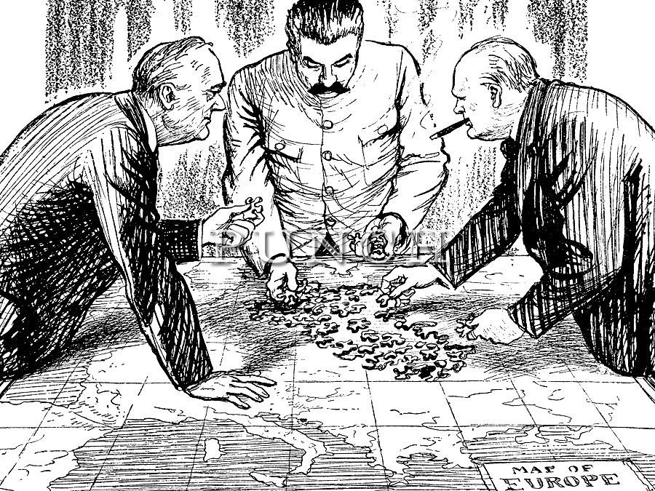

Slide 3
Atlantic Charter: In 1941 U.S. President Roosevelt and British Prime Minister Winston Churchill announced the Atlantic Charter, which set forth Allied goals for World War II and the postwar period. The two nations pledged to respect “the right of all peoples to choose the form of government under which they will live” and promised a free world without war, after the final destruction of Nazi tyranny.
Sphere-of-influence: Refers to a major power’s domination over a geographic area.
Nuremberg Trials: Public trials of former Nazi leaders at the end of World War II. The charges included waging aggressive war and crimes against humanity

Slide 4
3.3.2 Describe the general agreements made at Yalta regarding the political future of Germany and Eastern Europe with reference to: - the division of Germany -free elections in Eastern Europe
Yalta: At Yalta, Crimea in February, 1945 Churchill, Roosevelt & Stalin. Yalta had been preceded by the Tehran Conference in 1943, and was followed by the Potsdam Conference in July 1945The meeting was intended mainly to discuss the re-establishment of the nations of war-torn Europe. All three leaders were attempting to establish an agenda for governing post-war Europe. They wanted to keep peace between post-world war countries.
Within a few years, with the Cold War dividing the continent, Yalta became a subject of intense controversy.

Slide 5
What did Yalta Mean?
Germany would be temporarily be divided into three zones, with Britain, the United States and the Soviet Union each controlling a zone. The former German capital Berlin, deep in the Soviet zone, would also be divided into three zones.
Poland Soviet troops occupied most of the region and Stalin was determined that the Eastern European countries of Poland Czechoslovakia, Hungary and Romania have pro-Soviet governments. Roosevelt and Churchill were reluctant to allow Poland to fall under Soviet control, Britain had entered WW II to guarantee Poland’s independence. Poland would be a test case for the future of all Eastern Europe. At the insistence of Roosevelt and Churchill, Stalin pledged that free elections would be held in Eastern European countries as soon as possible.

Slide 6
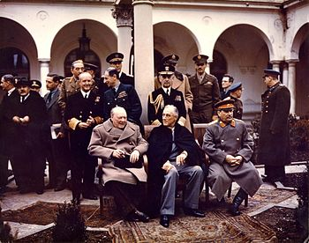
Yalta Conference in February 1945 with (from left to right) Winston Churchill, Franklin D. Roosevelt and Joseph Stalin

Slide 7
Key Terms decided at Yalta
Agreement to the priority of the unconditional surrender of Nazi Germany. After the war, Germany and Berlin would be split into four occupied zones.
Stalin agreed that France would have a fourth occupation zone in Germany, but it would have to be formed out of the American and British zones.
Germany would undergo demilitarization and denazification.
German reparations were partly to be in the form of forced labour. (see also Forced labor of Germans after World War II and Forced labour of Germans in the Soviet Union). The forced labour was to be used to repair damage that Germany inflicted on its victims.
Creation of a reparation council which would be located in the Soviet Union.
The status of Poland was discussed. It was agreed to reorganize the communist Provisional Government of the Republic of Poland that had been installed by the Soviet Union "on a broader democratic basis."

Slide 8
Key Terms decided at Yalta
The Polish eastern border would follow the Curzon Line, and Poland would receive territorial compensation in the west from Germany.
Stalin pledged to permit free elections in Poland, but forestalled ever honouring his promise.
Citizens of the Soviet Union and of Yugoslavia were to be handed over to their respective countries, regardless of their consent.
Truman obtained a commitment by Stalin to participate in the UN.
Stalin requested that all of the 16 Soviet Socialist Republics would be granted UN membership. This was taken into consideration, but 14 republics were denied; Truman agreed to membership for Ukraine and Byelorussia while reserving the right, which was never exercised, to seek two more votes for the United States.[8]
Stalin agreed to enter the fight against the Empire of Japan

Slide 9
3.3.3 Draw conclusions about how differing interpretations of the Yalta agreements between the Soviet Union and the West might pose future tension over Germany and Eastern Europe.
The Russians were given control over Poland, but only until it could reasonable hold free democratic elections. The definition of when this would occur was largely left up to Stalin.
Following Yalta, in Russia, when Soviet Foreign Minister Vyacheslav Molotov expressed worry that the Yalta Agreement's wording might impede Stalin's plans, Stalin responded "Never mind. We'll do it our own way later.“
The Soviet Union had already annexed several occupied countries as (or into) Soviet Socialist Republics, other countries in eastern Europe that it occupied were converted into Soviet-controlled satellite states. The US and the UK leaders became very wary of Stalins intentions of created a Communist East, and it was clear that those in Poland who supported western influence would be persecuted.

Slide 10
Eventually the United States and the United Kingdom made concessions in recognizing the then Communist-dominated regions, sacrificing the substance of the Yalta Declaration, while it remained in form.
A Communist government was installed in Poland. Many Poles felt betrayed by their wartime allies (mainly Britain) Many Polish soldiers refused to return to Poland, because of the Soviet repressions of Polish citizens (1939–1946) The result was the Polish Resettlement Act 1947, Britain's first mass immigration law.
The Polish Resettlement Act 1947 was the first ever mass immigration legislation of the Parliament of the United Kingdom. It offered British citizenship to over 200,000 displaced Polish troops on British soil who had fought against Nazi Germany and opposed the Soviet takeover of their homeland.

Slide 11
3.3.4 Analyze the decisions reached at Potsdam regarding contentious issues relating to Poland and Germany
Held near Berlin, the Potsdam Conference (July 17-August 2, 1945) was the last of the World War II meetings held by the “Big Three” heads of state. Featuring American President Harry S. Truman, British Prime Minister Winston Churchill (and his successor, Clement Attlee) and Soviet Premier Joseph Stalin, the talks established a Council of Foreign Ministers and a central Allied Control Council for administration of Germany. The leaders arrived at various agreements on the German economy, punishment for war criminals, land boundaries and reparations. Although talks primarily centered on postwar Europe, the Big Three also issued a declaration demanding “unconditional surrender” from Japan.

Slide 12
Postdam
On July 26, the leaders issued a declaration demanding ‘unconditional surrender’ from Japan.
A Council of Foreign Ministers was agreed upon, with membership from the Big Three plus China and France.
Military administration of Germany was established, with a central Allied Control Council
The leaders arrived at various agreements on the German economy, placing primary emphasis on the development of agriculture and non-military industry.
The institutions that had controlled the economy under the Nazis were to be decentralized, but all of Germany would be treated as a single economic unit.
War criminals would be brought to trial
Postwar Europe dominated the agenda, but the war in the Pacific lurked offstage. Truman received word of the successful atomic bomb test soon after he arrived at Potsdam; he told Churchill the news but mentioned ‘a new weapon’ only casually to Stalin

Slide 13
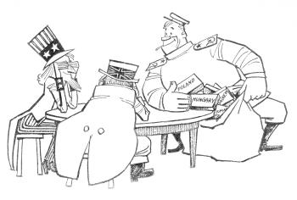

Slide 14
3.3.5 Evaluate how new leaders and technological developments increased tension at Potsdam
President Truman saw things in black and white terms, with little room for compromise. As a result he adopted a “get tough” attitude with the Soviets. He believed the Soviets were acting like a bully in Europe and should be made to mend its ways. Unlike Roosevelt, Truman was highly suspicious of the Soviets and had no intention of working closely with Stalin like Roosevelt. This new approach towards the Soviets increased tensions.
In August 1945 the United states ended WWII by dropping atomic bombs on the Japanese cities of Hiroshima and Nagasaki.

Slide 15
The Weapon of Mass Destruction
The atomic bomb became a source of tension for several reasons:
1. Truman had not told Stalin that the U.S. intended to drop these on Japan.
2. The U.S. refused to share the secret of how to make such a bomb.
3. Stalin was convinced the U.S. would use the bomb to win worldwide power.
4. Stalin ordered his scientists to develop an atomic bomb.
The U.S. felt threatened by this.

Slide 16
3.3.6 Analyze the challenges faced by the United Nations with reference to its: -structure -purposes and principles
One of the allies' goals during WWII was to create an international organization to ensure global collective security.
Thus the United Nations was created in October 1945.
Its purpose was to:
1. maintain international peace & settle disputes
2. develop equal rights & national self determination
3. solve social, economic & humanitarian problems
Some of the basic principles of the United Nations were:
1. the equality of all members
2. all members fulfill its UN obligations
3. settle disputes peacefully
4. refrain the use of force against any state
5. help the UN in any action it undertakes

Slide 17
The Memory of the Inefficient LON
The League of Nations had been too weak to stop aggression because major powers were unwilling to give up their self-interest to such an international organization. President Roosevelt was determined to make the United Nations a strong organization by ensuring that all major powers be involved.
The solution was to divide the UN into two parts:
The General Assembly in which each country had one vote and the Security Council controlled by the major powers.

Slide 18
Structure
The structure of the United Nations presented some challenges:
General Assembly:
All members met in the assembly to present their positions on issues.
Each country has 1 vote, most decisions are reached by a simple majority.
On questions of peace or expulsion of a member, a majority of 2/3's is required.
Critics say the General Assembly is an ineffective “talk shop” where nations simply play politics.
Security Council:
The real power behind the UN is the Security Council, which is made up of 2 groups:
Five permanent members: China, France, Britain, Russia and the United States. Permanent members have veto power which is the right to stop any UN action.
Ten non-permanent members: elected for two year terms
The major responsibility of the Security Council is to maintain peace and security. It can order a ceasefire, impose economic sanctions and authorize the use of military force against an aggressor.

Slide 19
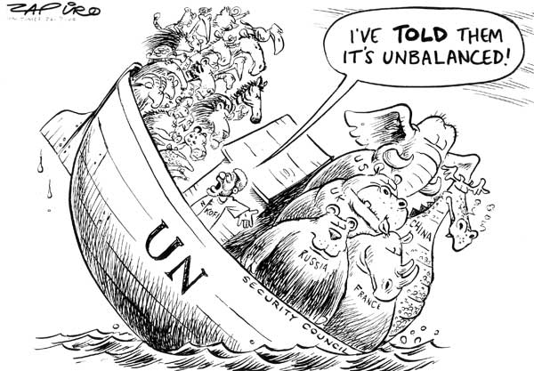

Slide 20
Critics Argue
Critics point out that the veto power of the permanent members is a weakness of the UN. They argue that countries will use the veto to block any UN action that is not in their self-interest.
During the Cold War the Security Council was often deadlocked as the U.S. and Soviets often used the veto against each other.
It must be pointed out that the veto power ensured the continuing commitment of all major powers and that there has been no large scale wars since its creation.

Slide 21
3.3.7 Use selected pieces of music, fashion, art or literature to show the impact of World War II on the daily lives of citizens.

