Slide 1
Animal Farm- English 1201
Mrs. Etsell

Slide 2
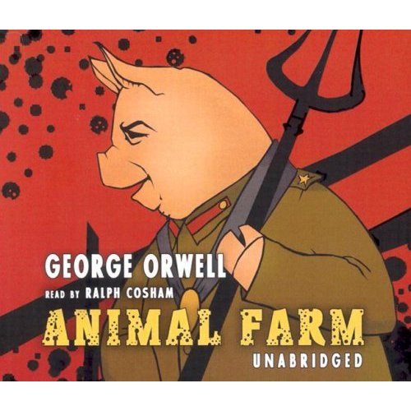
Animal Farm- George Orwell

Slide 3
Totalitarianism
centralized control by an autocratic authority
the political concept that the citizen should be totally subject to an absolute state authority

Slide 4
Intro to Totalitarianism
You Tube Videos
Lisa Ling- For National Geographic on North Korea
BBC Documentaries on North Korea

Slide 5
The Characters- Animals
The Animals
Major An old boar whose speech about the evils perpetrated by humans rouses the animals into rebelling. His philosophy concerning the tyranny of Man is named Animalism by his followers. He also teaches the song "Beasts of England" to the animals.
Snowball A boar who becomes one of the rebellion's most valuable leaders. After drawing complicated plans for the construction of a windmill, he is chased off of the farm forever by Napoleon's dogs and thereafter used as a scapegoat for the animals' troubles.

Slide 6
The Characters
Napoleon A boar who, with Snowball, leads the rebellion against Jones. After the rebellion's success, he systematically begins to control all aspects of the farm until he is an undisputed tyrant.
Squealer A porker pig who becomes Napoleon's mouthpiece. Throughout the novel, he displays his ability to manipulate the animals' thoughts through the use of hollow yet convincing rhetoric.
Boxer A dedicated but dimwitted horse who aids in the building of the windmill but is sold to a glue-boiler after collapsing from exhaustion.

Slide 7
The Characters
Mollie A vain horse who prefers ribbons and sugar over ideas and rebellion. She is eventually lured off the farm with promises of a comfortable life.
Clover A motherly horse who silently questions some of Napoleon's decisions and tries to help Boxer after his collapse.
Benjamin A cynical, pessimistic donkey who continually undercuts the animals' enthusiasm with his cryptic remark, "Donkeys live a long time."
Moses A tame raven and sometimes-pet of Jones who tells the animals stories about a paradise called Sugarcandy Mountain

Slide 8
The Characters
Bluebell, Jessie, and Pincher Three dogs. The nine puppies born between Jessie and Bluebell are taken by Napoleon and raised to be his guard dogs.

Slide 9
The Characters- The Humans
Mr. Jones The often-drunk owner of Manor Farm, later expelled from his land by his own animals. He dies in an inebriates' home after abandoning his hopes to reclaim his farm.
Mrs. Jones Jones' wife, who flees from the farm when the animals rebel.
Mr. Whymper A solicitor hired by Napoleon to act as an intermediary in Animal Farm's trading with neighboring farms.
Mr. Pilkington The owner of Foxwood, a neighboring and neglected farm. He eventually sells some of his land to Napoleon and, in the novel's final scene, toasts to Napoleon's success.
Jones; Mr. Frederick An enemy of Pilkington and owner of Pinchfield, another neighboring farm. Known for "driving hard bargains," Frederick swindles Napoleon by buying timber from him with counterfeit money. He later tries to attack and seize Animal Farm but is defeated.

Slide 10
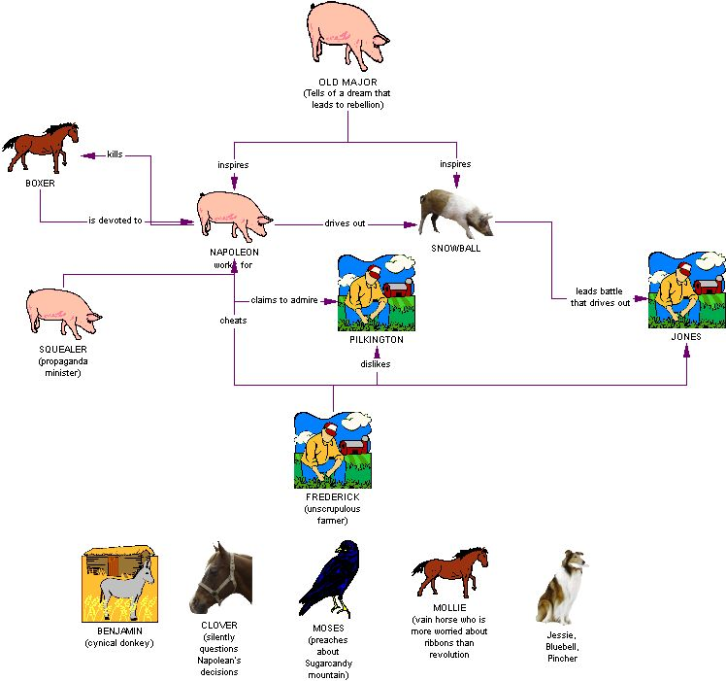

Slide 11
Themes
Themes are the fundamental and often universal ideas explored in a literary work.

Slide 12
The Corruption of Socialist Ideals in the Soviet Union
Animal Farm is most famous in the West as a stinging critique of the history and rhetoric of the Russian Revolution. Retelling the story of the emergence and development of Soviet communism in the form of an animal fable, Animal Farm allegorizes the rise to power of the dictator Joseph Stalin

Slide 13
The Societal Tendency Toward Class Stratification
Animal Farm offers commentary on the development of class tyranny and the human tendency to maintain and reestablish class structures even in societies that allegedly stand for total equality. The novella illustrates how classes that are initially unified in the face of a common enemy, as the animals are against the humans, may become internally divided when that enemy is eliminated.

Slide 14
The Danger of a Naïve Working Class
One of the novella’s most impressive accomplishments is its portrayal not just of the figures in power but also of the oppressed people themselves. Animal Farm is not told from the perspective of any particular character, though occasionally it does slip into Clover’s consciousness. Rather, the story is told from the perspective of the common animals as a whole. Gullible, loyal, and hardworking, these animals give Orwell a chance to sketch how situations of oppression arise not only from the motives and tactics of the oppressors but also from the naïveté of the oppressed, who are not necessarily in a position to be better educated or informed.

Slide 15
The Abuse of Language as Instrumental to the Abuse of Power
One of Orwell’s central concerns, both in Animal Farm and in 1984, is the way in which language can be manipulated as an instrument of control. In Animal Farm, the pigs gradually twist and distort a rhetoric of socialist revolution to justify their behavior and to keep the other animals in the dark. The animals heartily embrace Major’s visionary ideal of socialism, but after Major dies, the pigs gradually twist the meaning of his words. As a result, the other animals seem unable to oppose the pigs without also opposing the ideals of the Rebellion

